Slide 1

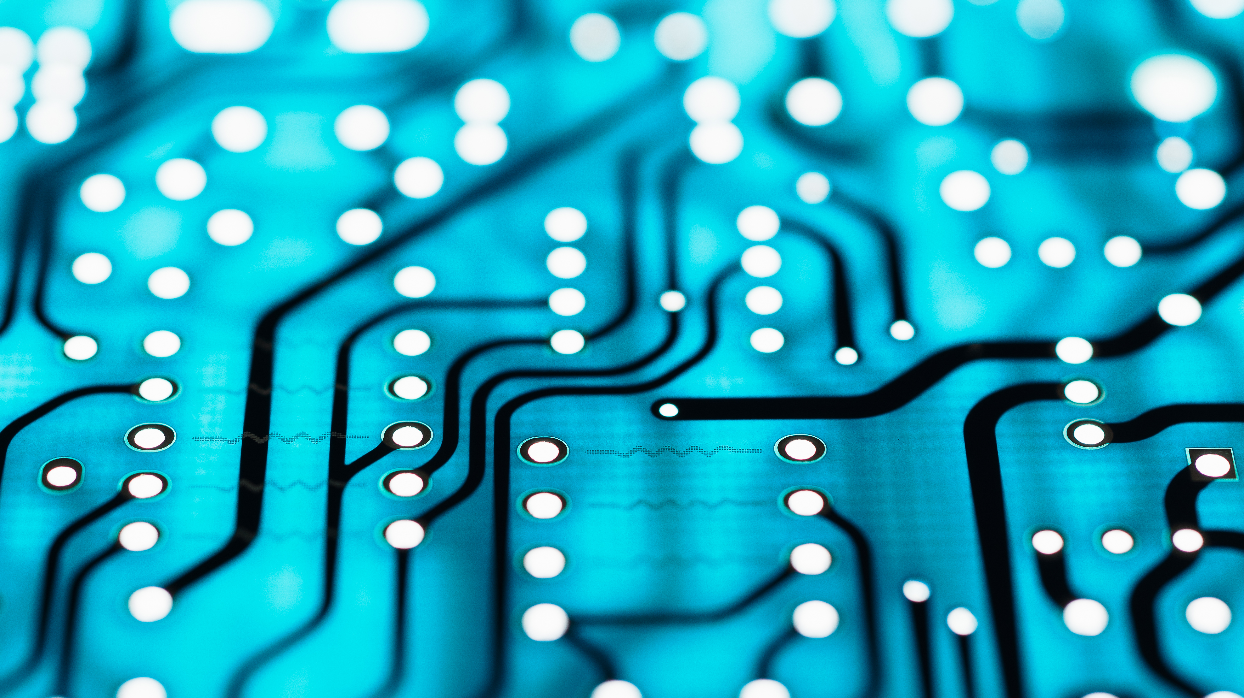

A Brief History of computer Technology
(My VIEW)
Notes:
This is my view of how computer technology has evolved through my career.

Slide 2
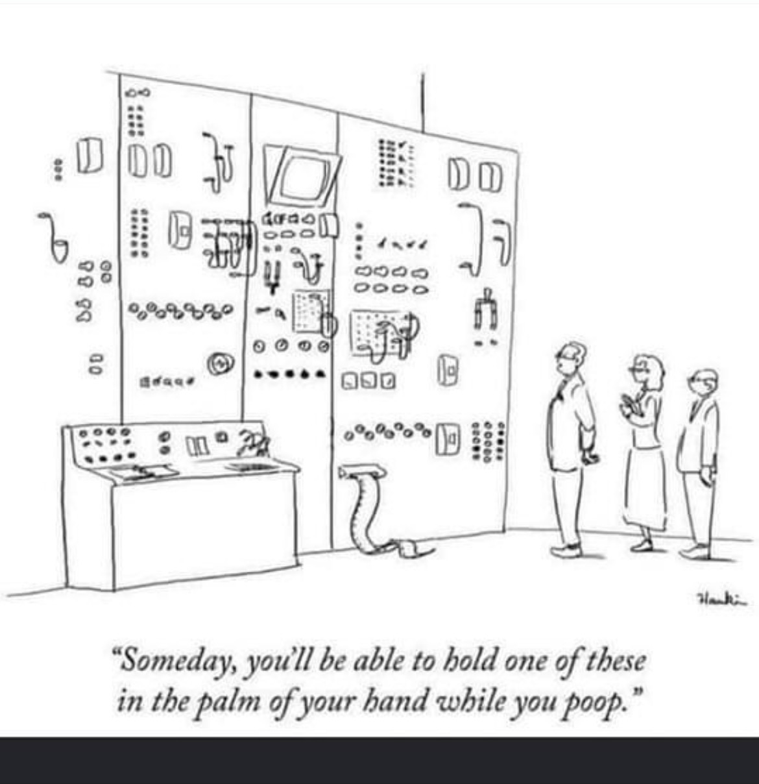
What influenced me to present this topic?
Notes:
I came across this cartoon one day soon after joining Torch and realized this could be a presentation.

Slide 3
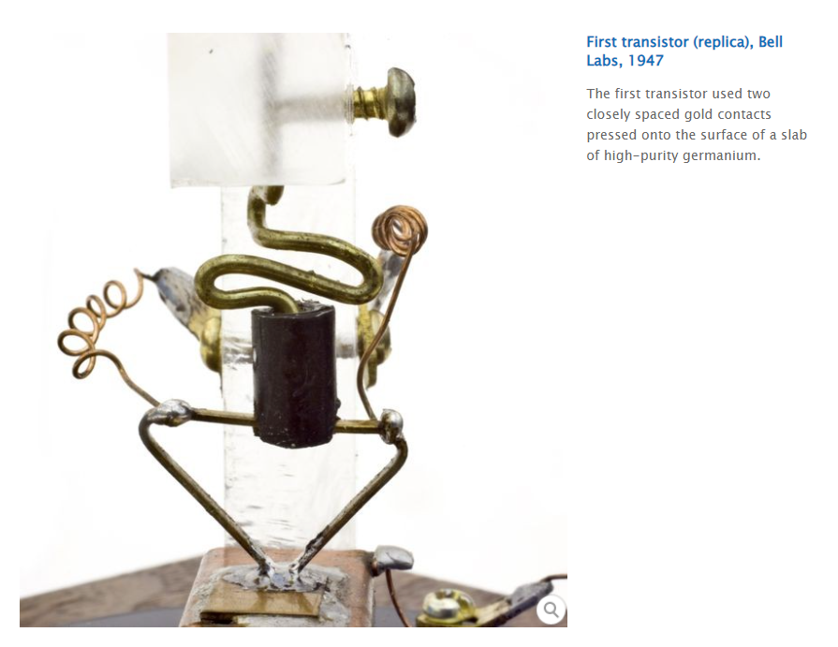
I was born in 1947
FOR ME THIS STORY STARTS HERE
So was the first transistor At Bell Labs
Notes:
Perfected in 1947 at Bell Labs the first transistor used a slab of Germanium about ¼ the size of a penny.
The transistor quickly evolved replacing vacuum tubes in many electronic circuits.
Huge size reduction
Lower power requirements
Lower heat dissipation requirements
Improvements in mean time to failure
It’s greatest value would be in igniting the development of computers, switches and a host of new electronic devices yet to come.
Following an agreement with the federal government, AT&T licensed the patents for the inventions of the transistor and related processes to other companies.
GE, RCA, Texas Instruments, …

Slide 4
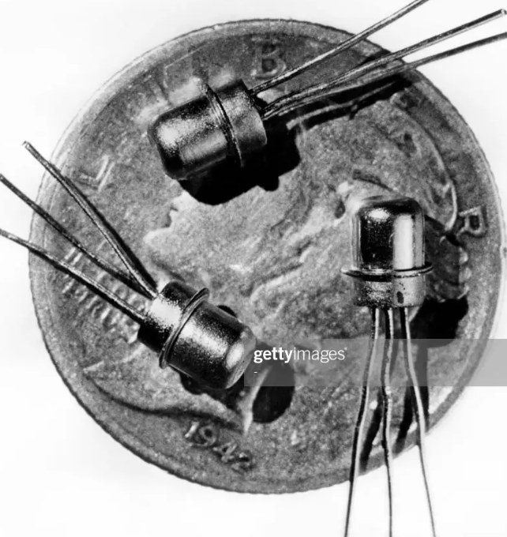
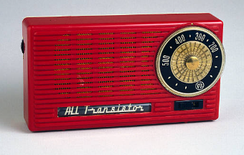
IMPORTANT TO NOTE
Moore’s Law
  In 1965 Gordon Moore the co-founder of INTEL Corp predicted that the number of transistors in a dense integrated chip (IC) would double every two years. He projected this to last a decade. In fact, it is still true today.
    Every two years you double the number of components crammed on an IC.
    By 1975 they were putting 65,000 components on a ¼” square IC chip.
    Today we are cramming well over 55 billion components on an IC chip.
Notes:
The first transistor radios were marketed in 1954 and incorporated 3 to 4 transistors.
Here you can see the size compared to a dime.

Slide 5
EARLY PIONEERS
JOHN NAPIER 1550 - 1617
  DICOVERER OF LOGARITHMS AND NAPIER’S BONES (THE FORRUNNER OF THE SLIDE RULE).
BLAISE PASCAL 1623 - 1662
  STATISTICAL SCIENCE.
ISAAC NEWTON 1642 - 1726
  CONTRIBUTIONS TO MATH AND PHYSICS.
JOSEPH JACQUARD 1752 - 1834
  1801 CONSTRUCTED A LOOM THAT USED A SERIES OF PUNCHED CARDS TO CONTROL THE PATTERN OF THREADS.
CHARLES BABBAGE 1791 – 1871 / ADA LOVELACE 1815 - 1852
  INVENTED TO FIRST MECHANICAL COMPUTER AND PROGRAMMING THEORY.
HERMAN HOLLERITH 1860 – 1929
  INVENTED THE PUNCHED CARD TABULATING MACHINE WHICH MODERNIZED THE STATISTICAL GATHERING AND ANALYSIS OF DATA FOR THE US CENSUS 1890 – 1950’S
  HIS COMPANY WOULD LATER BE COMBINED WITH OTHERS TO FORM IBM IN 1926.
Notes:
Napier
Mathematician, physicist, astronomer, the discover of logarithms.
Pascal
Mathematician, physicist, inventor.
Development of probability theory (used in actuarial science).
Inventor of mechanical calculators capable of addition and subtraction.
Newton
Mathematician, physicist, astronomer, alchemist.
Contributions to calculus, optics, laws of motion, gravity.
Jacquard
French weaver and merchant.
Developed a loom that used a series of punched cards to create a repeating pattern for cloths and carpets without the intervention of a weaver.
Babbage
Mathematician and inventor credited with conceiving the first automatic digital computer.
Idea to mechanically calculate mathematical tables.
Small mechanical calculators, Difference Engine (never completely completed)
Discuss relationship and importance of Ada Lovelace
Daughter of Lord Byron(a Luddite)
Often referred to as the first computer programmer
The size, difficulty in machining parts at the time, expertise limited to a few, not completed in his lifetime.

Slide 6
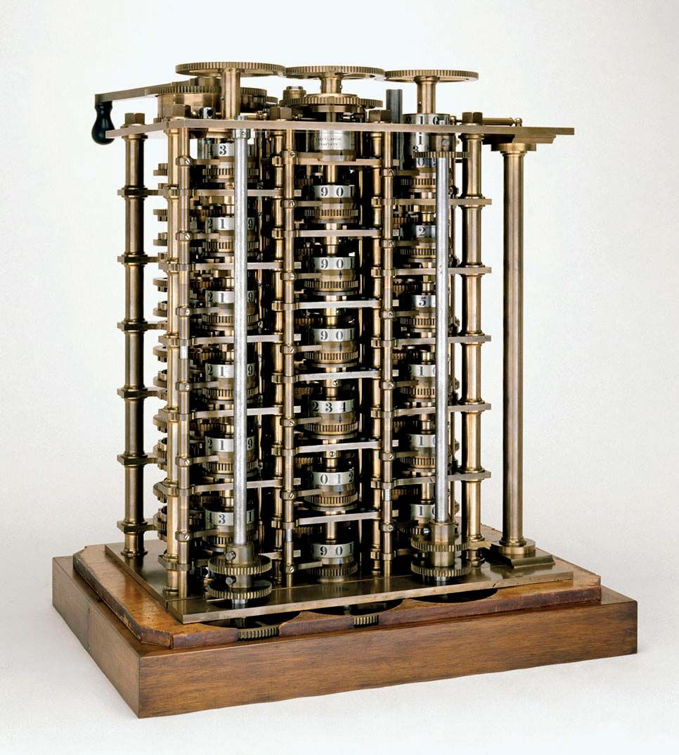
Difference Engine
The completed portion of Charles Babbage's Difference Engine, 1832. This advanced calculator was intended to produce logarithm tables used in navigation. The value of numbers was represented by the positions of the toothed wheels marked with decimal numbers.
Science Museum London

Slide 7
Early Pioneers
(continued)
ALAN TURING 1912 – 1952
  CONSIDERED TO BE THE FATHER OF THERORETICAL COMPUTER SCIENCE AND ARTIFICIAL INTELLIGENCE.
VANEEVER BUSH 1890 – 1974
  DEAN OF MIT SCHOOL OF ENGINEERING AND FOUNDER OF RAYTEON CORP.
    BEST KNOWN FOR HIS WORK ON ANALOG COMPUTERS.
HOWARD AIKEN 1900 - 1973
  PHD IN PHYSICS AT HARVARD, INSPIRED BY CHARLES BABBAGE
  DEVELOPED THE HARVARD MARK 1, 2, 3, AND 4 ALONG WITH IBM, HARVARD, THE NAVY, AND MANY TALENTED PEOPLE.
JOHN MAUCHLY 1907 – 1980 J PRESPER ECKERT 1919 - 1995
  DISIGNER OF THE ENIAC AND FOUNDERS OF UNIVAC CORP.
GRACE HOPPER 1906 – 1992
  RETIRED USN REAR ADMIRAL.
  MAJOR COLLABORTOR WITH HOWARD AIKEN AND MAUCHLY/ECKERT.
  DEVELOPER OF COBOL. ORIGINATOR OF THE TERM “COMPUTER BUG”
Notes:
Turing
Mathematician, computer scientist, logician, cryptologist, theoretical biologist.
Worked at Bletchley Park during WW II, crucial in breaking German ciphers.
Continued to research and assist in the development post WW II.

Slide 8

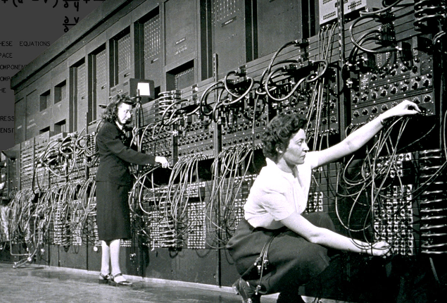
Computing during the
1940’s
The Eniac
Programming the Eniac
18,000 vacuum tubes, 88,700 electronic components, 5,000,000 hand soldered joints, 8X3X100 feet
27 tons, consumed 150 kW of electricity
$487,000 ($6,000,000+ today), first uses = study of thermonuclear weapons, artillery firing tables
Continuous operation 1946 to 1955

Slide 9
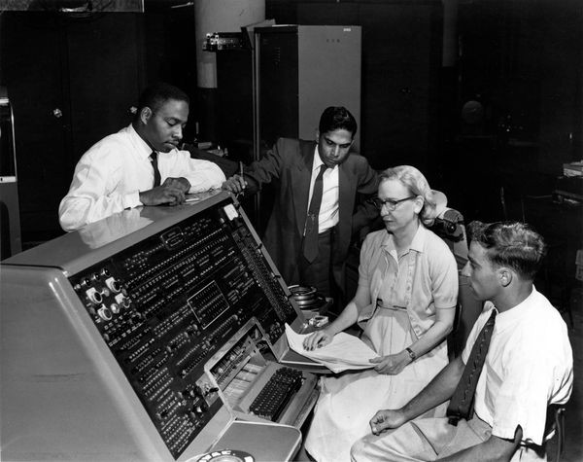
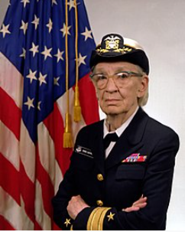
Computing during the
1940’s AND 1950’S
Harvard Mark 1 – 4 Series
Grace Hopper 1906 – 1992
Retired US Navy Rear Admiral
First programs ran in 1944 aided Manhattan Project
Notes:
The Mark 1 could do 3 additions or subtractions in a second. A multiplication to 6 seconds and a division took 15.3 seconds and Logarithm of trigonometric function took over 1 minute.
Grace Hopper:
Grace Brewster Murray Hopper (December 9, 1906 – January 1, 1992)
-An American computer scientist, mathematician, and United States Navy rear admiral.^{[1]}
-One of the first programmers of the Harvard Mark I - 4 computers, she was a pioneer of computer programming.
-Hopper was the first to devise the theory of machine-independent programming languages, and the FLOW-MATIC programming language she created using this theory was later extended to create COBOL, and other early high-level programming language still in use today.
Many awards
Navy commissioned the USS Grace Hopper, an Arleigh Burke class guided missile destroyer in 1997.

Slide 10
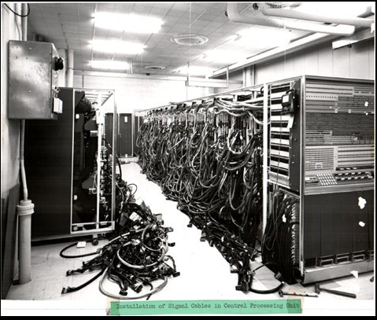
Computing during the 1950’s to the early 1960’s AND BEYOND
IBM
BELL LABS
NCR
NSA SECRET HARVEST SUPERCOMPUTER BUILT BY IBM 1962
RAYTEON
ARMED SERVICES
HARVARD, MIT, IOWA STATE…
VARIOUS BUSINESS AND UNIVERSITY
RESEARCH CENTERS IN
THE US AND OTHER COUNTRIES
NSA
BORROUGHS
SPERRY UNIVAC
COMPACT
NASA
DATA GENERAL
HONEYWELL
WANG
HEWLIT PACKARD
RCA
CDC
CRAY
MICROSOFT
INTEL
AMDAHL
FUGITSU
XEROX
APPLE
AMD
TOSHIBA
HITACHI
SUN
DEC
HOSPITALS
BANKS
MANUFACTURING
SCHOOLS
RETAIL
Notes:
Harvest:
2nd Gen Computer for its use of transistors.
Fastest computer in the world until the CDC 6600 became operational in 1964.
$7,800,000
Used about 170,000 transistors

Slide 11
BY THE 1960’S BUSNISES THAT NEEDED TO MANAGE AND ANALISE LARGE AMOUNTS OF DATA WERE
BEGINNING TO AQUIRE COMPUTERS
ACCURACY
COMPLEXITY OF HANDLING LARGER AMOUNTS OF DATA
ALLOW PEOPLE TO BE MORE EFFICIENT
IMPROVE PROCESSES AND REDUCE THE TIME IT TAKES TO COMPLETE TASKS
MAINTAIN A COMPETITVE ADVANTAGE WITH THE COMPETITION

Slide 12
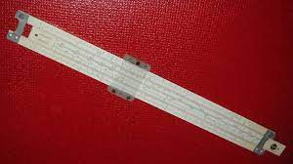
What Fed my early interest
Science FICTION of the 1950’s and 60’s
Books
NASA and the Space Race to the moon
Media
My FIRST Heath Kit Catalog
Math
School in general + that first basic electricity course in High school
Slide Rule:
Dates from the 1600’s in popular use into the 1970’s

Slide 13
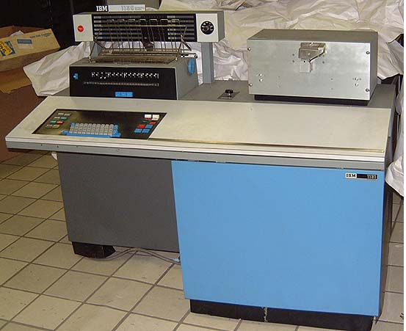
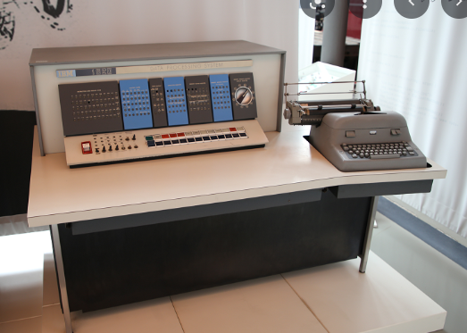
1966 -1968
Early Education at MATC (MIT)
- Computer Theory and Programming
IBM 1130
Introduced in 1965
IBM 1620
Introduced in 1959
Rented for $1,000/mo
1130 Primary language = Fortran, Assembler
1MB disk, paper tape, punched card, printer, plotters
1620 Primary language = Fortran
1MHz Processor
Notes:
All Transistor based = 2nd Generation of computers
The 1130 and the DEC PDP series of computers were introduced around the same time.
Dec was more popular, both had a great impact in the educational, research and business community.
About 10,000 1130’s were sold/rented before the product was discontinued.

Slide 14
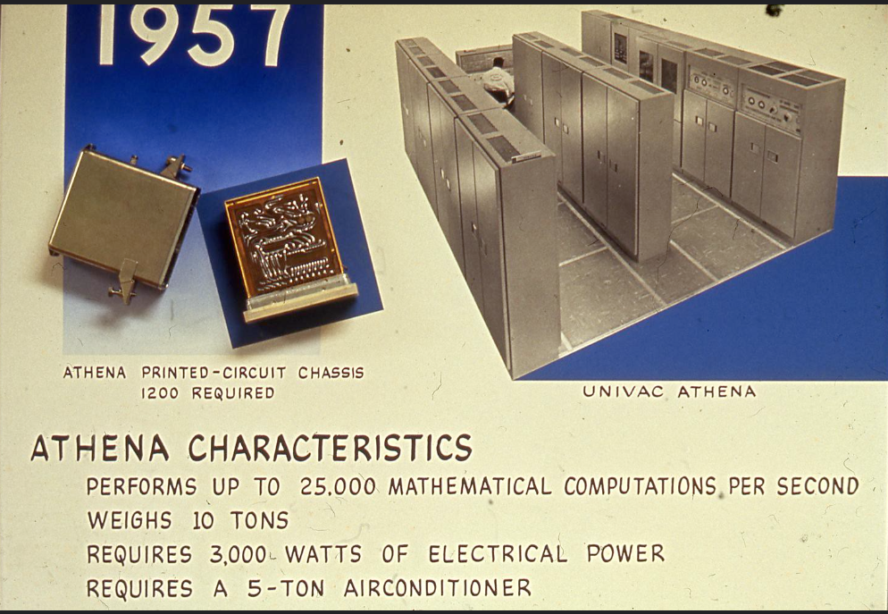
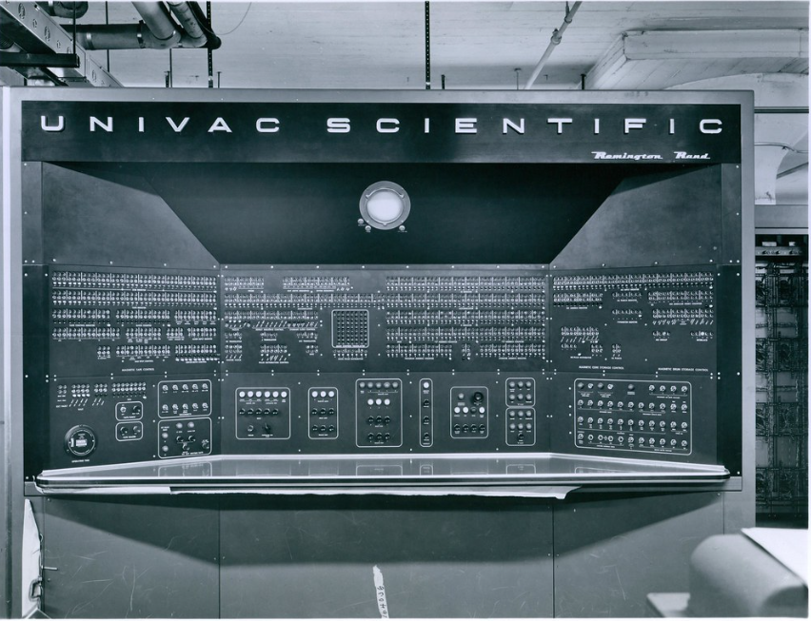
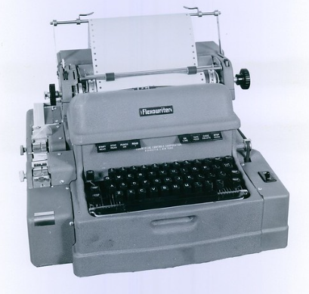
1966 -1968
Early Education at MATC (MIT)
Univac Athena Scientific Primarily used by the Military and Scientific community
CBS News borrowed a UNIVAC computer to predict the outcome of the race for US president in 1951 between Dwight D. Eisenhower and Adlai Stevenson. Opinion polls predicted strong support for Stevenson, but the UNIVAC´s analysis of early returns showed a clear victory for Eisenhower.
Notes:
2nd Generation Computer
10 cabinets on 13.5 X 20foot floor plan weighing 9.5 tons.
Used by the military as a missile guidance computer
Cost = $1,800,000
When the government declared the computers surplus they went to various colleges and universities
MATC was fortunate to obtain one

Slide 15
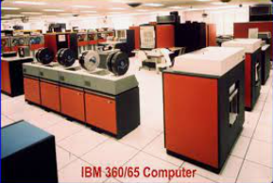
1968 – 1969
Bell Labs
IBM 360/67
Introduced by IBM in 1965
Used to support various research projects and product development at the Labs
Notes:
3rd generation of computer technology

Slide 16
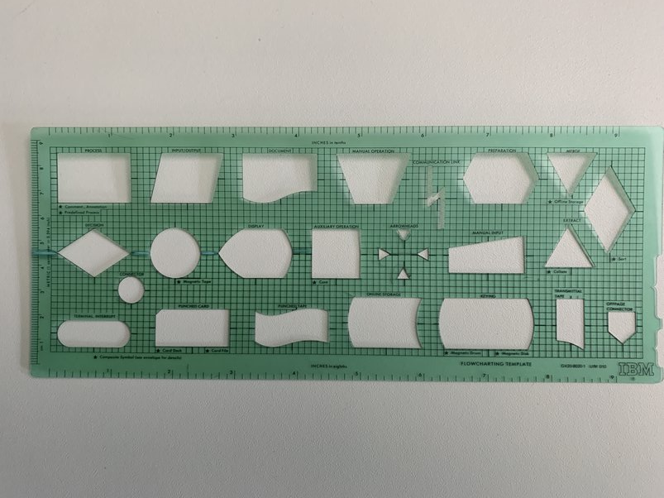
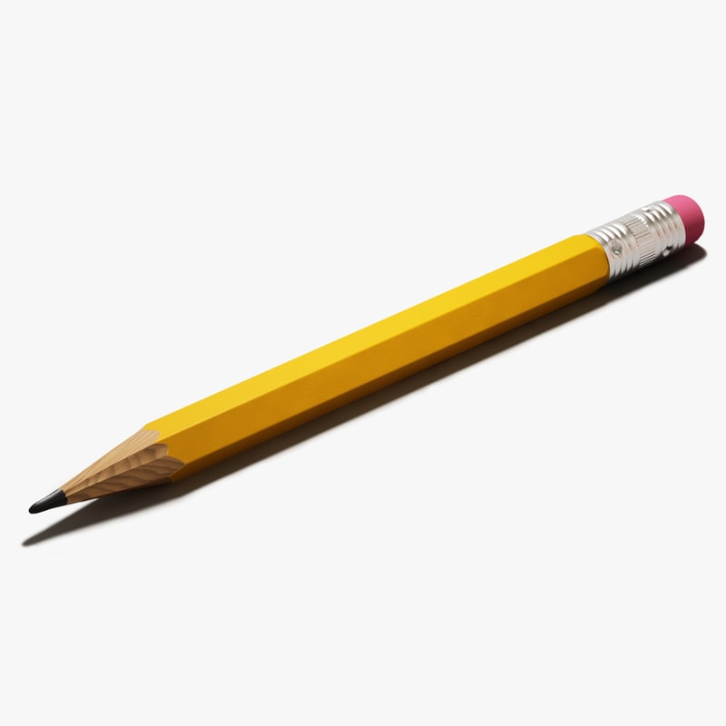
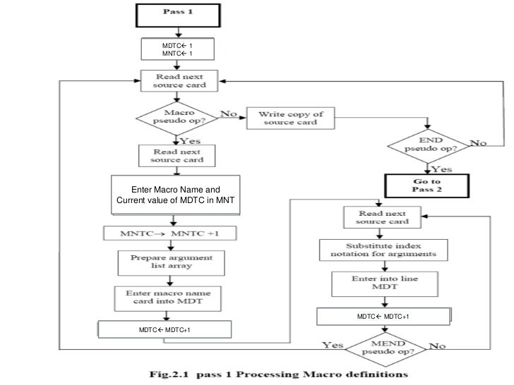
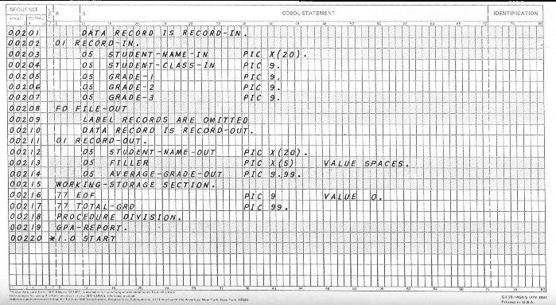
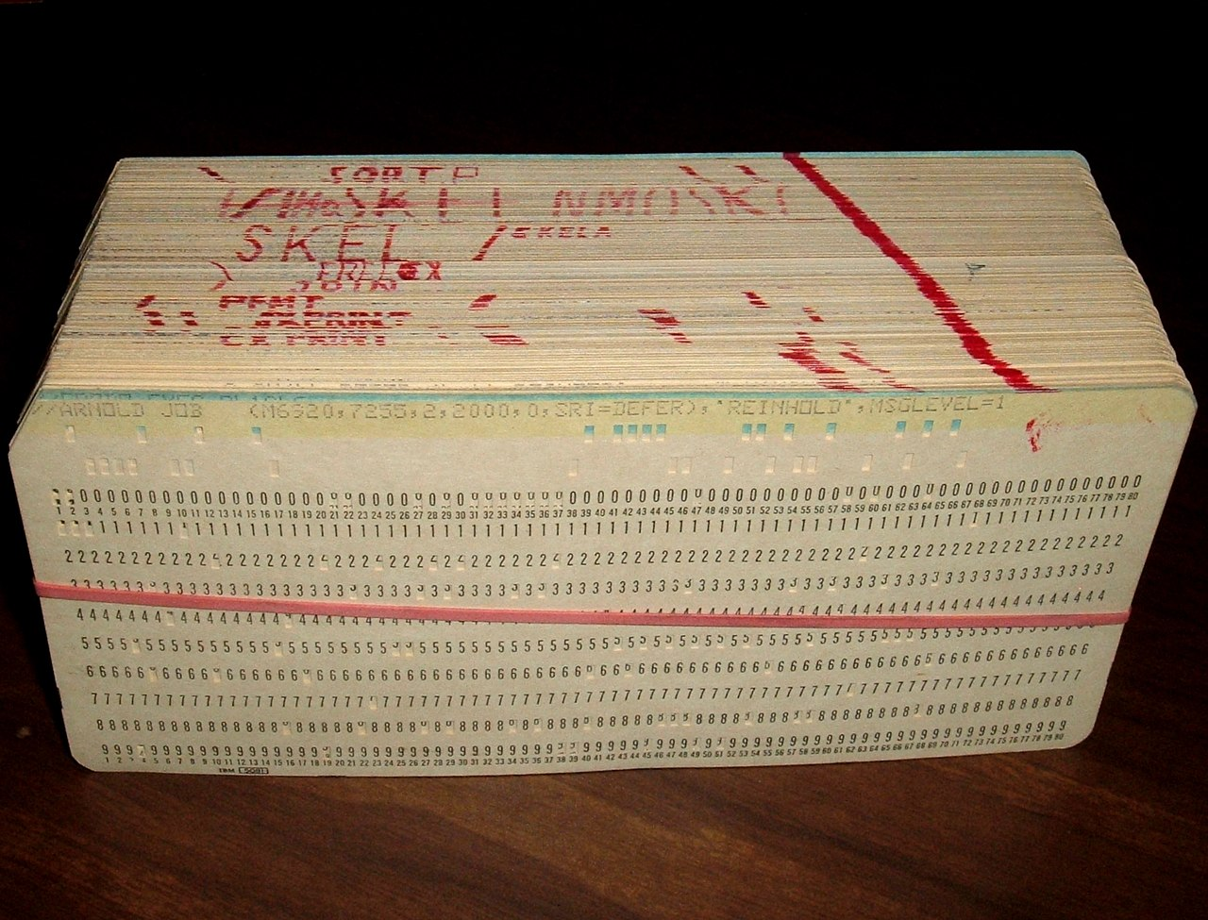
OUR TOOLS THROUGH THE LATE 1970’S

Slide 17
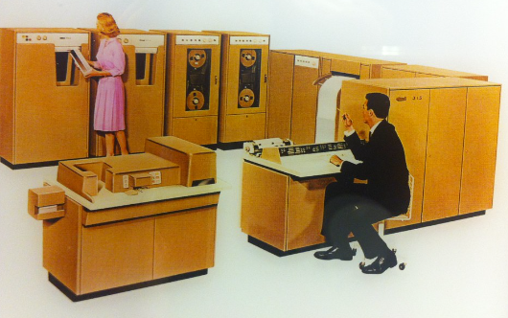
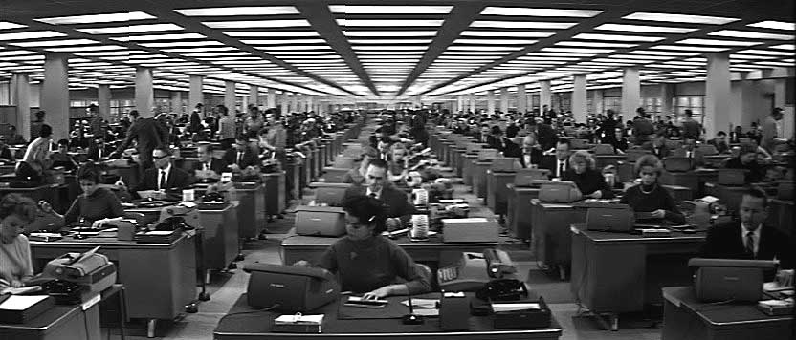
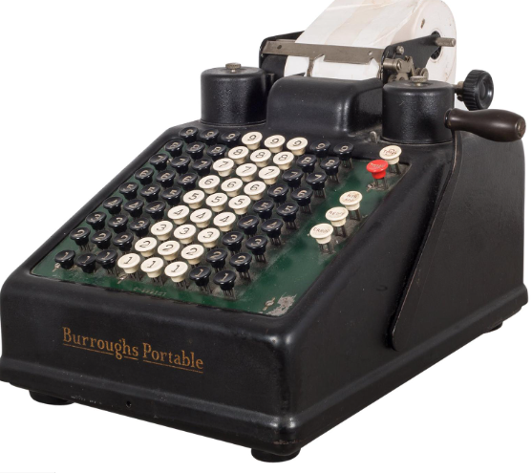
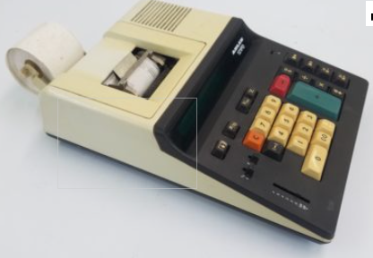
1969 – 1974
Local Paper Company
NCR 315 Computer
Typical Accounting Area of the Time
1969 Use of Mechanical Burroughs Adding Machines
1970’s Use of Electronic Adding Machines

Slide 18
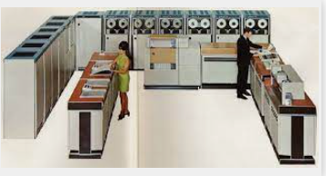
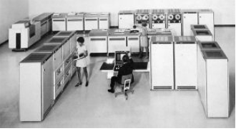
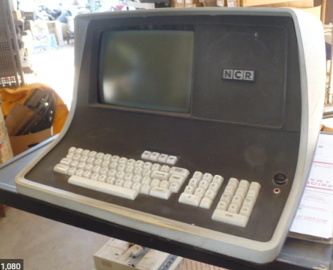
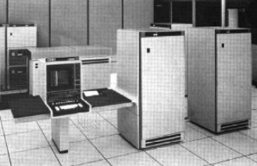
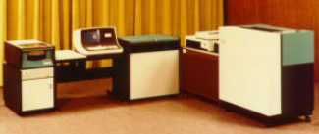
1974 - 1985
NCR Century 200
NCR Century 300
NCR Criterion 8600
NCR 8200 Mini (used at Plants)
Later phased out by DEC and Windows Server based systems

Slide 19
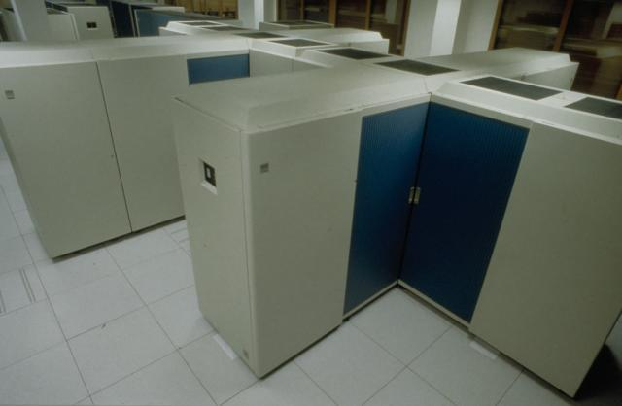
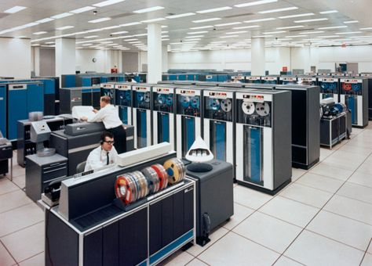
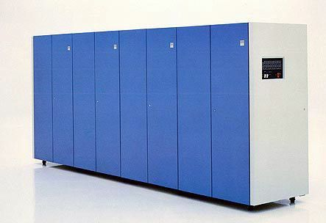
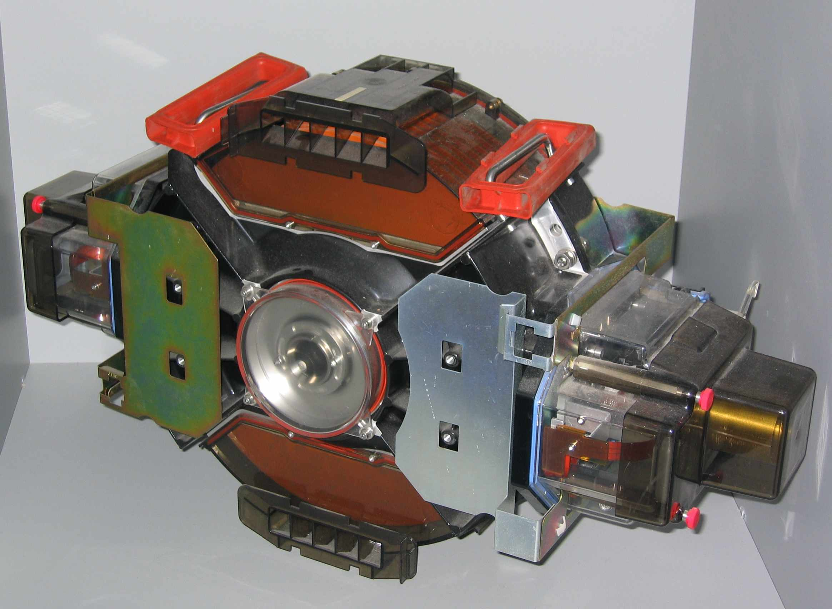
1985 – 1994
IBM 3090 SERIES 18 TO 45 MIPS
TYPICAL TAPE LIBRARY
3380 DISK DRIVES
Each cabinet housed 2 drives with a capacity of 2.5 GB (550lbs)
Notes:
IBM 3081 Liquid cooled
IBM 3090 Liquid cooled
IBM ES/9000 Air cooled
AS/400
Windows Server(s)

Slide 20
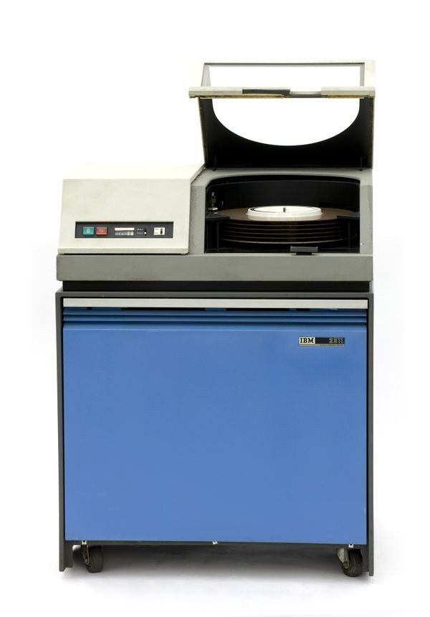
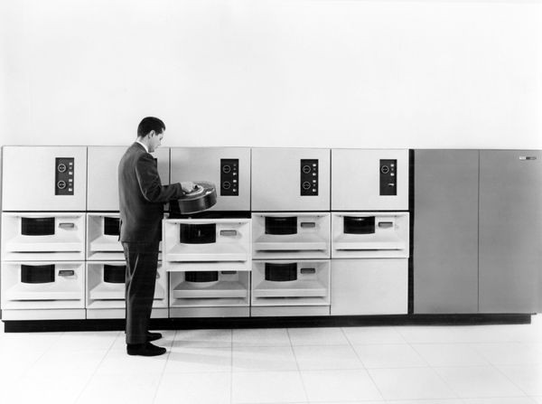
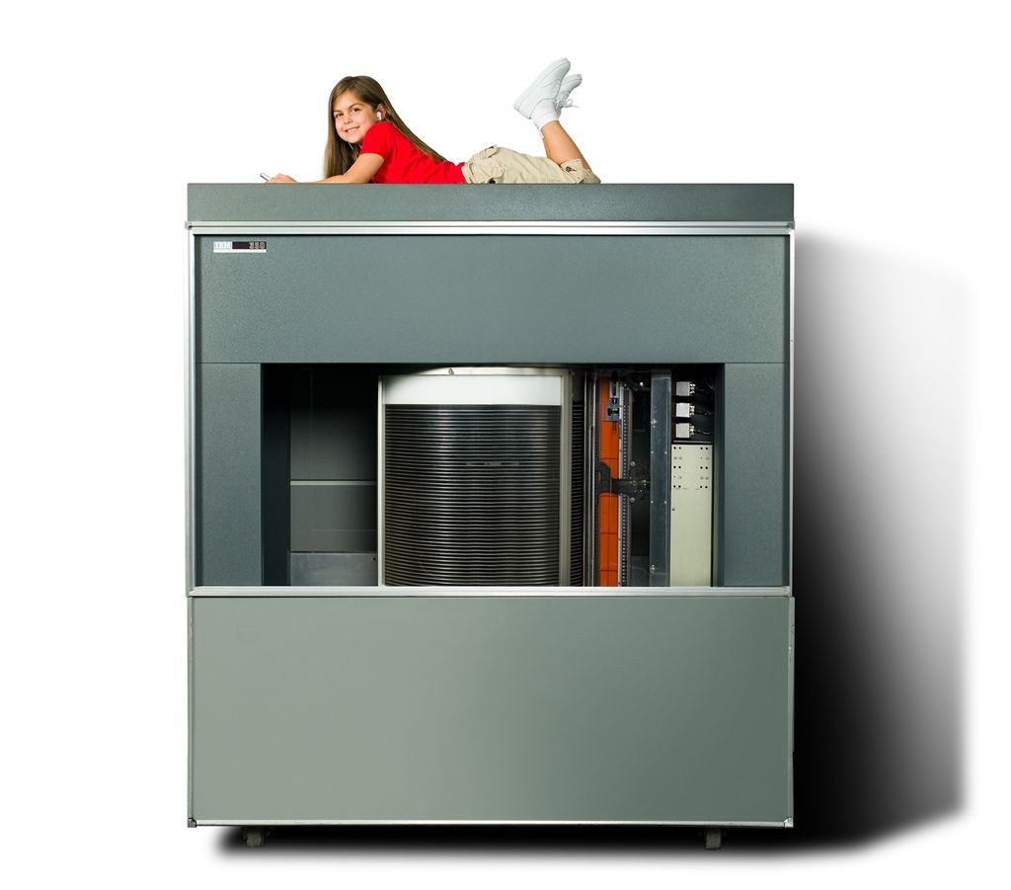
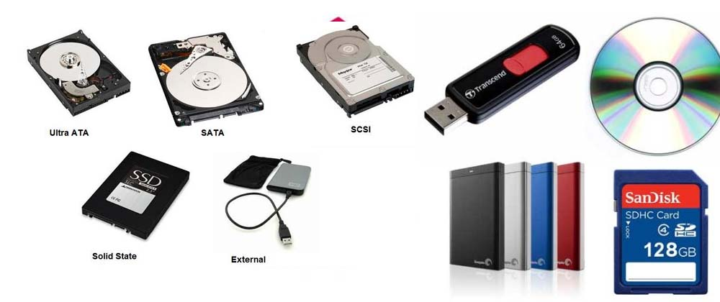
IN CONTRAST
The first commercial disk drive built by IBM.
3.75MB
Delivered in 1956.
7.25MB 1964
29MB 1965
Today
Weight = 2300 lbs.
Cost = $34,500
Today = $300,000

Slide 21
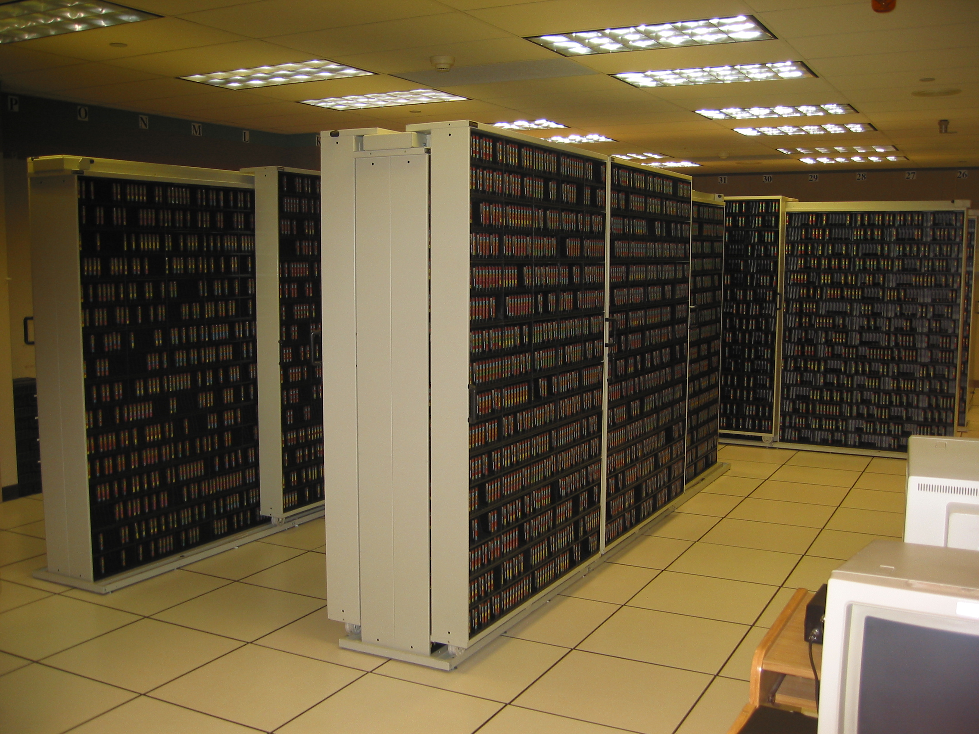
Tape library (about 40,000 cartridges on and off-site)

Slide 22
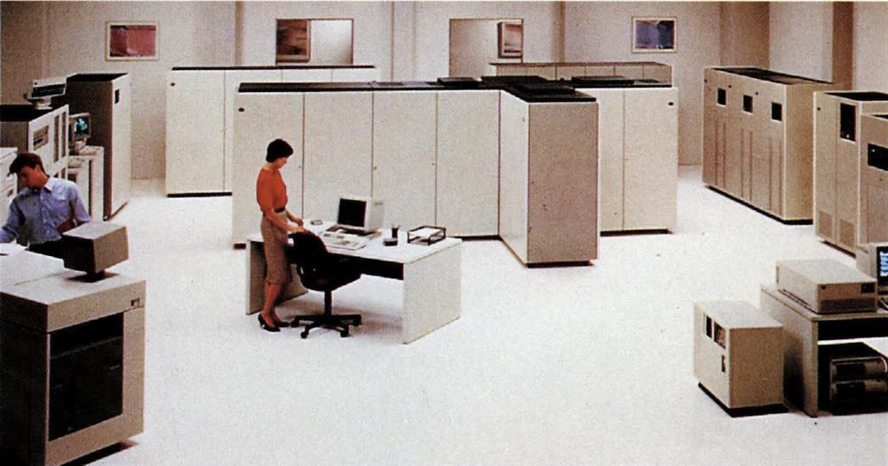
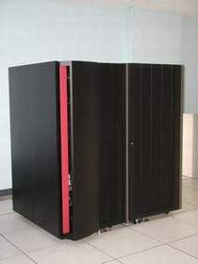
1994 - 2004
IBM 9021 SERIES 118 to 171 MIPS
IBM 9672-R26 CMOS SERIES 219 MIPS
(WATER COOLED)

Slide 23
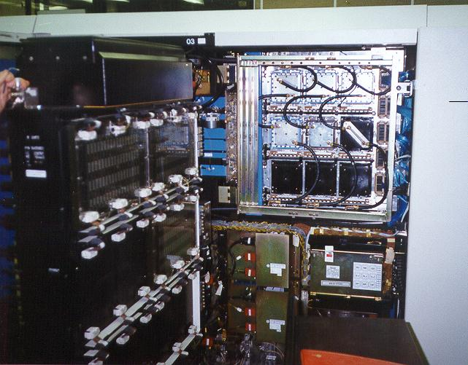
Inside view of one of the water-cooled mainframe cabinets

Slide 24
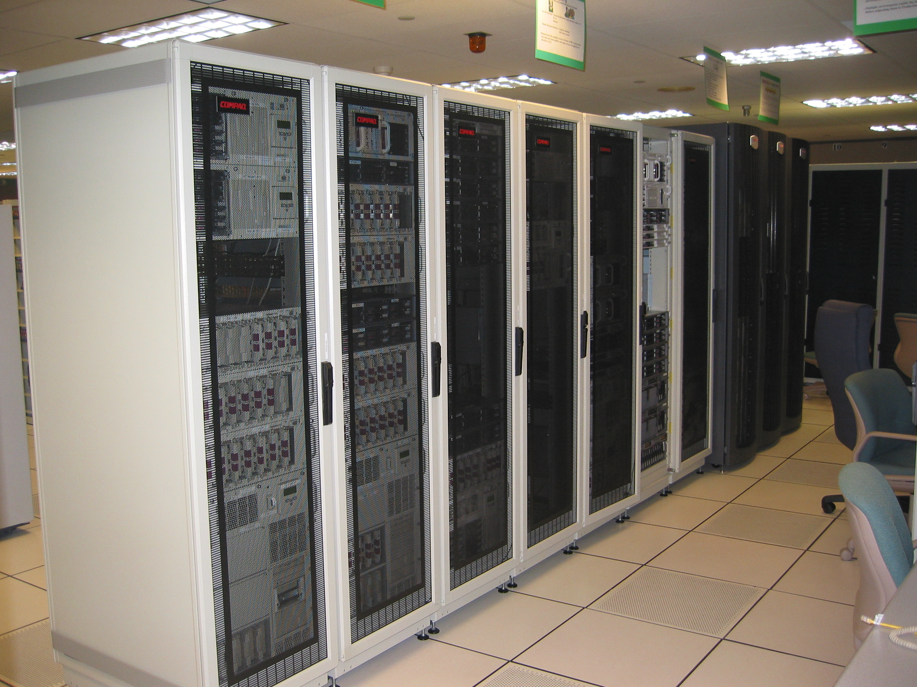
Part of the Server Farm

Slide 25
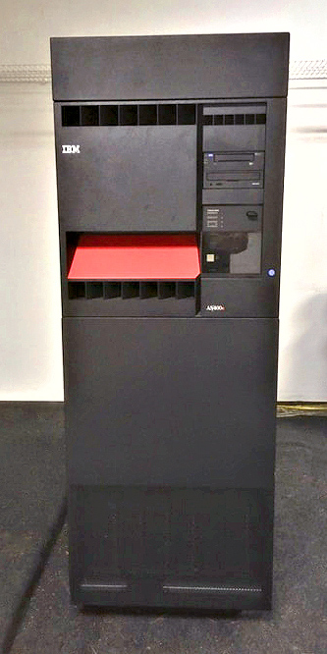
2004 +
AS400 OR IBM SYSTEM i
About the size of a large refrigerator in your kitchen

Slide 26
Other uses of computing DURING THIS TIME
1960’S TO PRESENT DAY
WANG Word-processing introduced into the Steno Pool eventually relaced by the personal computer.
Computerized phone system replaces the telephone switchboard.
IBM Compatible PCs and Laptops gradually replace calculators, typewriters, WANG WP, and eventually become the desktop standard for most people in the company.
  Word-Processing
    Word Perfect eventually replaced by MS-Word.
  Spreadsheets
    VisiCalc, Super-Calc, Multiplan, Lotus 123 and eventually XCEL.
Digital Equipment Corp (DEC) computer systems
Windows servers running specialized applications for departments
Email
The Internet

Slide 27
Several more things to note
Moore’s Law
  In 1965 Gordon Moore the co-founder of INTEL Corp predicted that the number of transistors in a dense integrated chip (IC) would double every two years. He projected this to last a decade. In fact, it is still true today.
    Every two years you double the number of components crammed on an IC.
    By 1975 they were putting 65,000 components on a ¼” square IC chip.
    Today we are cramming over 55 billion components on an IC chip.
Xerox Corp
  So successful they had large amounts of cash on hand and this fostered lots of internal research.
    One of these efforts was developing computer systems with A Graphical User Interface (GUI) and the use of a mouse.
    In 1979 Steve Jobs and a team made the first of many visits to Xerox PARC and saw the XEROX computers (XEROX ALTO) running in office spaces with a GUI, word processor, drawing tool and other GUI based programs they had developed.
    This event solidified/jump started Apples recent direction of research and development. They (Apple) had just recently started up what would become the Lisa and Macintosh projects. The rest is history.
Microsoft

Slide 28
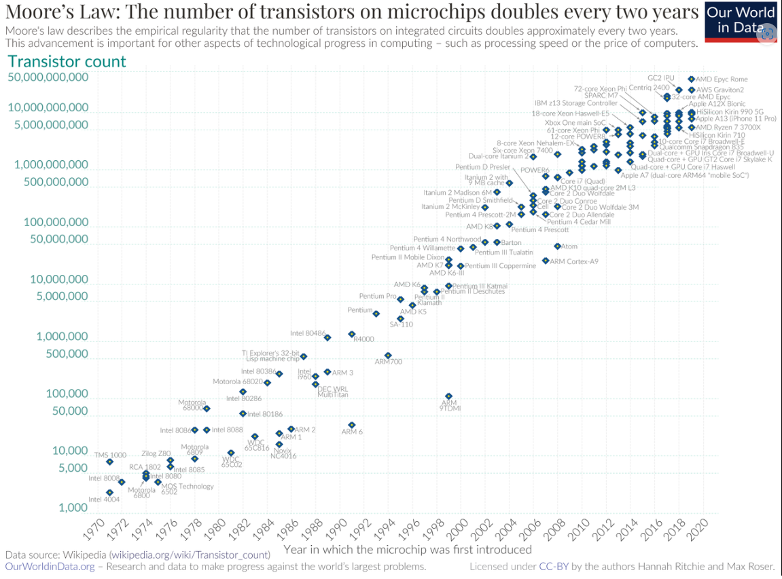

Slide 29
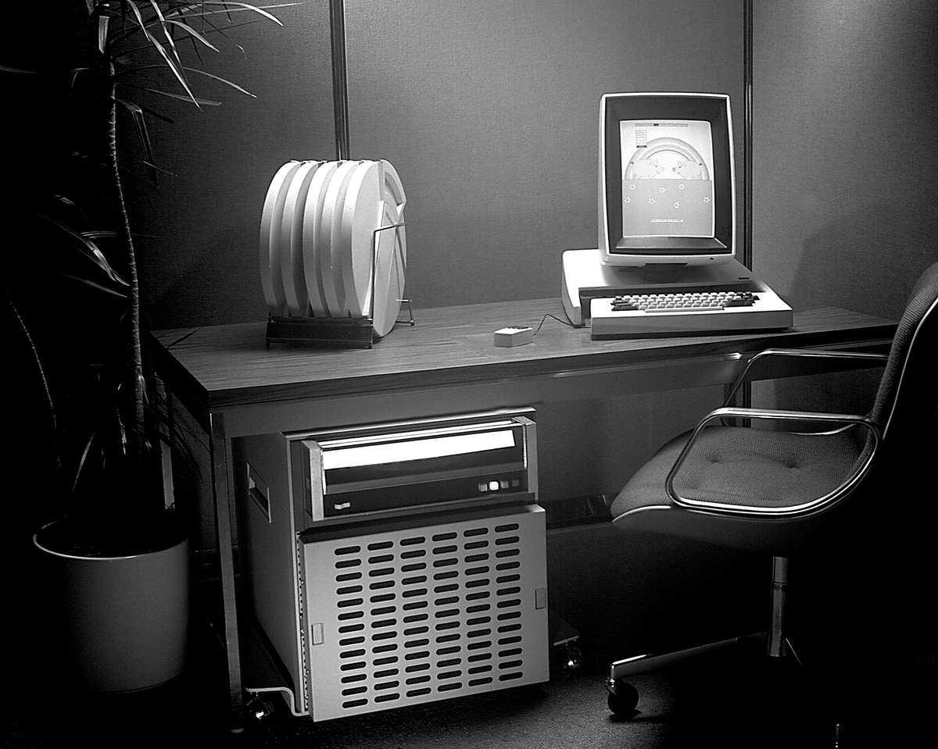
Xerox Alto Computer
First developed in 1972 as a research project
128KB of memory (at the cost of $4000)
2.5MB removable cartridge hard drive.
5.8 MHz CPU based on a chip built by Texas Instruments(TI).
64-key keyboard
The display is the same dimensions as a regular (8.5″x11″) sheet of paper, aligned vertically).
First to have a WYSIWYG display.
Three-button mouse.
Notes:
Xerox Alto
First developed in 1972 as a research project
128KB of memory (at the cost of $4000)
2.5MB removable cartridge hard drive.
5.8 MHz CPU based on a chip built by Texas Instruments(TI).
64-key keyboard and a 5-finger key set.
Bit-mapped black and white display sized 606 × 808 (the same dimensions as a regular (8.5″x11″) sheet of paper, aligned vertically).
Three-button mouse.
Cost about $10,000 to build.
About 2,000 built mainly used within Xerox and sold to prestigious universities.
Linked together at Xerox by Ethernet (a new technology at the time).
First system to offer a WYSIWYG GUI interfaced.
Greatly influenced the future of Apple (Lisa and Macintosh), Microsoft, DEC, Sun, IBM and other technology companies.

Slide 30
What’s next
Artificial Intelligence (AI)
Cloud Computing
Virtual Reality
Security of our information
Robotics
Quantum Computing

Slide 31
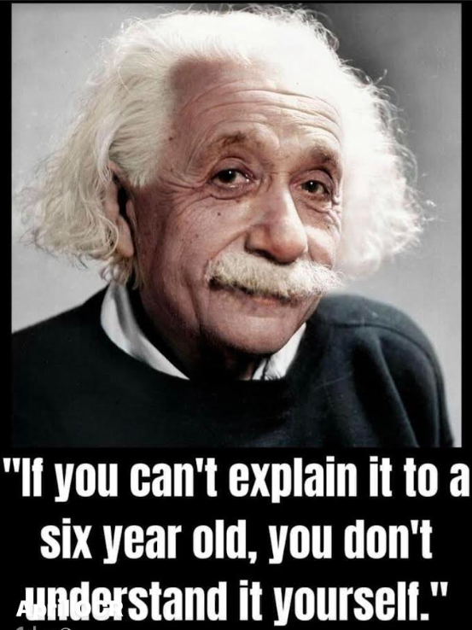
I’m stopping here because as one famous person once said

Slide 32
Questions? discussion anything you’d like to share?
Thank you!

