Slide 1
100th Anniversary of Women’s Suffrage
Presented to the
Club of the Fox Valley
October 10, 2019 by Barbara Kelly
Notes:
This presentation was developed from a variety of things put together by the educational resources sub-committee of the 100th Anniversary of Women’s Suffrage steering committee. I’m a member of the steering committee and the chair of the educational resources committee. Most of the beautiful powerpoint was created by Linda Bjella. I edited it, and added things from the “Talking points for Speaker’s Bureau volunteers” that I wrote.

Slide 2
Women’s Suffrage
The Why, the How, the Who,
the When, and the What of It
Notes:
From our perspective of the 21st century, it’s hard to imagine women not having the right to vote. But when you put it in the context of the time and place in which this 72-year long struggle began, you begin to understand the why, the how, the who, then when, and the what of it. Some definitions that may be of value in understanding the language.

Slide 3
Key Definitions
Suffrage: from Latin suffragium, a vote given in deciding a controversial question or electing a person for office
Partial Suffrage: A term in the suffrage movement referring to the ability to vote in elections on specific matters, such as municipal elections, school board elections, liquor licenses, etc.
Suffragist: A woman who fought for the right to vote
Suffragette: At the time of the Women’s suffrage movement, a term used to belittle and demean suffragists. Over time, suffragette has become a popular term used to describe suffragists.

Slide 4
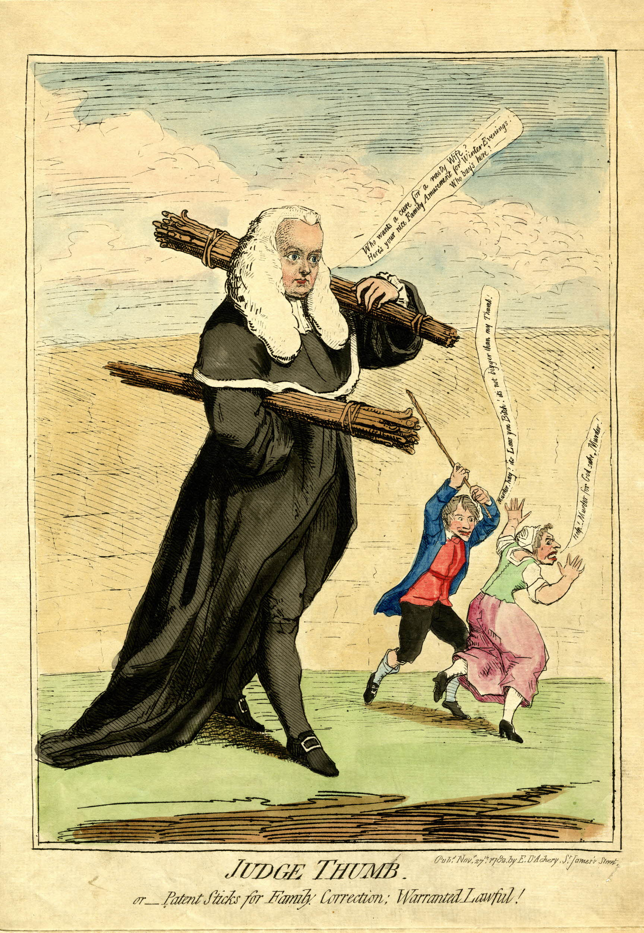
“THE LAW OF THE THUMB”
Notes:
Our forefathers based their laws on the European tradition of church law. The historian Herbert Spencer wrote, “Our laws are based on the all-sufficiency of man’s rights, and society exists today for woman only in so far as she is in the keeping of some man.” In other words, women were considered property in the eyes of the law, so the law prescribed the means by which husbands could keep their wives in line. This was sometimes called the “rule of thumb” which said the husband could “chastise his wife with a whip or rattan no bigger than his thumb to enforce domestic discipline.”
In 1910, the U.S. Supreme Court ruled that a wife had no cause for legal action against her husband for domestic abuse because it would “open the doors of the courts to accusations of all sorts of one spouse against another and bring into public notice complaints for assault, slander, and libel.”

Slide 5
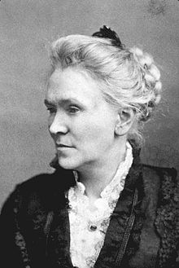
Matilda Joslyn Gage
“A proper self-respect cannot inhere
in any person under governmental
control of others.”
Notes:
Did early suffragists get some of their inspiration from Native American women? Matilda Joslyn Gage wrote extensively about them. Gage was active in the early formation of the suffrage movement, but since she held more liberal views, she didn’t rise to the forefront of the movement. Gage was also an ardent abolitionist and an outspoken critic of injustice toward Native Americans. She must have spent a great deal of time with them because she was initiated into the Iroquois Wolf Clan and admitted into its Council of Matrons. In her writing, she compared the status of Iroquois women to that of Euro-American women.

Slide 6
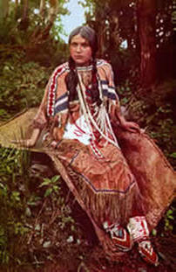
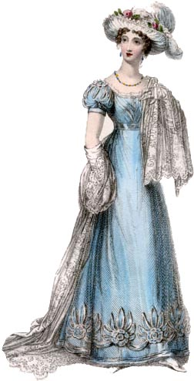
WOMEN’S RIGHTS Haudenonsaunee Iroquois vs EuroAmerican Women’s Rights
SOCIAL SOCIAL
CHILDREN WERE MEMEBERS OF CHILDREN WERE SOLE PROPERTY
THE MOTHER’S CLAN. OF FATHERS.
VIOLENCE AGAINST WOMEN WAS NOT HUSBANDS COULD LEGALLY PHYSICALLY
PART OF THE CULTURE AND DEALT DISCIPLINE OR ABUSE THEIR WIVES.
WITH SERIOUSLY.
CLOTHING FOSTERED HEALTH, FREEDOM CLOTHING WAS RESTRICTIVE,
OF MOVEMENT AND INDEPENDENCE. UNHEALTHY AND DANGEROUS.
Notes:
Take a minute to read through these stark comparisons.

Slide 7
ECONOMIC ECONOMIC
WORK IS DONE COMMUNALLY. WORK IS ISOLATED DRUDGERY.
WOMEN WERE RESPONSIBLE FOR WOMEN WERE RESPONSIBLE FOR HOME
HOME AND AGRICULTURE. UNDER SUBORDINATION TO THE HUSBAND.
WOMEN OWNED PROPERTY AND HAD WOMEN HAD NO RIGHTS TO PROPERTY OR
RIGHTS TO DECISIONS ABOUT HER TO DECISIONS ABOUT HER BODY
BODY AND CHILDREN. OR CHILDREN.

Slide 8
POLITICAL POLITICAL
WOMEN CHOSE THEIR CHIEF. IT WAS ILLEGAL FOR WOMEN TO VOTE.
WOMEN HELD KEY POLITICAL OFFICES. WOMEN WERE EXCLUDED FROM POLITICAL OFFICE.
TRIBAL LAW ENSURED WOMEN’S POLITICAL COMMON LAW DEFINED MARRIED WOMEN AS AUTHORITY WHETHER SINGLE OR MARRIED. “DEAD TO THE LAW”.
DECISION-MAKING WAS BY CONSENSUS AND DECISION-MAKING WAS BY MAJORITY AND
EVERYONE HAD A VOICE. MAJORITY RULED AMONG THOSE MEN.
SOURCE: SISTERS IN SPIRIT BY SALLY ROESCH WAGNER

Slide 9
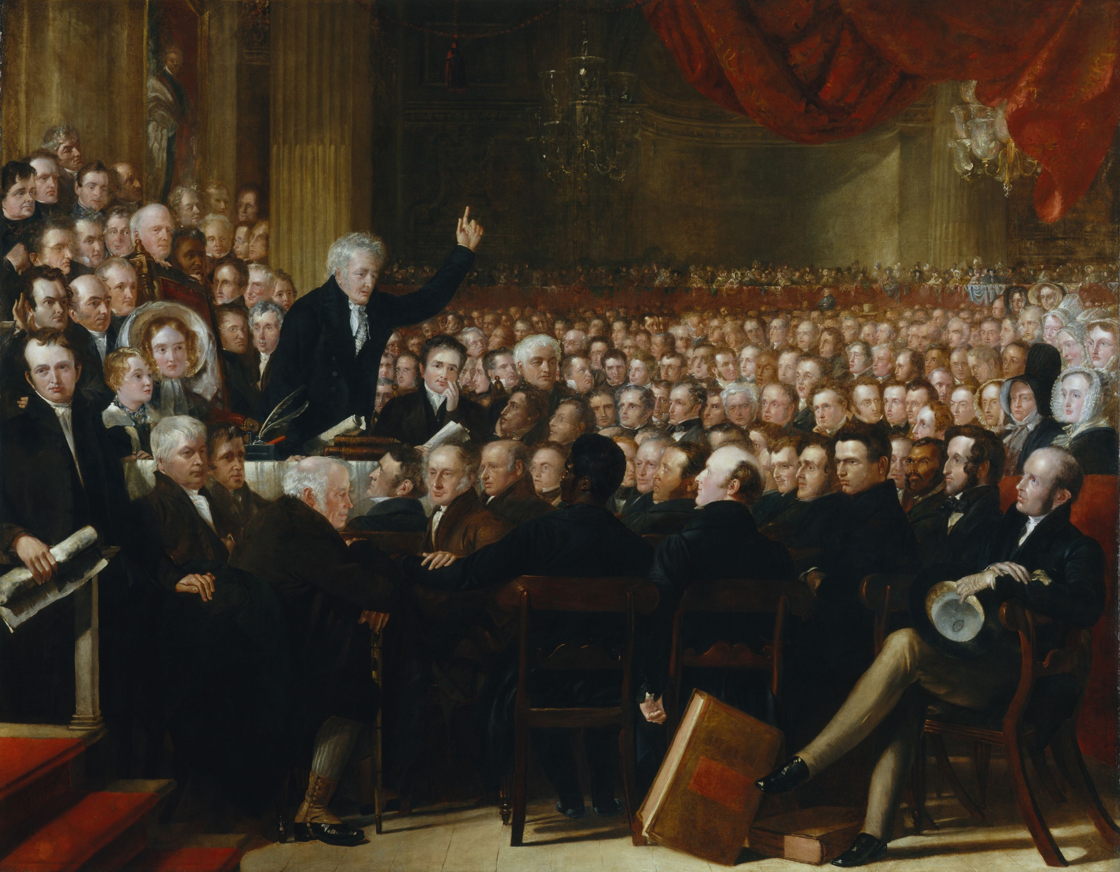
QUAKERS ☞ ABOLTIONISTS ☞ SUFFRAGISTS
The 1860 World Anti-Slavery Convention in London
Notes:
Quakers believe all are people are created equal under God. They were the first to oppose slavery in America and among the most active in the abolitionist movement. Unlike other Christian sects, Quakers also believed in equality among men and women. This painting of the World Anti-Slavery Convention in London depicts the delegates debating. Who is debating? Where are the women? The women were placed behind a screen and not allowed to speak on the convention floor.

Slide 10
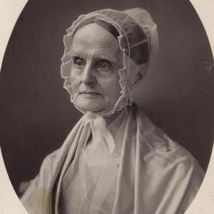
LUCRETIA MOTT
”The world has not yet seen a truly great
and virtuous nation because in degradation
of woman are the very fountains of life
poisoned.”
Notes:
Sitting behind that screen was Mrs. Lucretia Mott. She and her husband, both Progressive Quakers, were leaders in the abolitionist movement. She was an eloquent Quaker minister herself. So ardent in her beliefs, she refused to wear cotton clothing or serve sugar in her home since both were produced with slave labor.

Slide 11
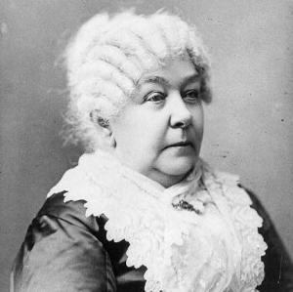
ELIZABETH CADY STANTON
“The best protection any woman can have is…courage.”
Notes:
Another woman attending that convention was the young, newly married Elizabeth Cady Stanton. Both she and her husband were abolitionists as well. Mrs. Mott and Mrs. Stanton sat together behind that screen in London, and fumed over the constraints placed upon them by the men at that convention. Before they returned home, they had resolved to hold a women’s rights convention in America.

Slide 12
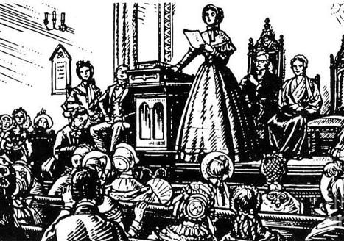
First women’s rights convention: July 19-20, 1848 in Seneca falls, NY
Notes:
Eight years later, Elizabeth Cady Stanton found herself far from the life she loved in Boston, living in the small town of Seneca Falls, NY. By then she had three small boys, and would go on to have seven children. She was bored and brimming over with ideas about women’s rights. She and Lucretia Mott met in Seneca Falls and along with a few other women hastily organized the first women’s rights convention to be held a week later. They placed a notice in the newspaper, not knowing what to expect. Much to their surprise, on the day of the convention in the small Methodist Wesleyan Chapel, 300 people arrived. For two days, there were spirited debates about the issues presented, the most significant of which was The Declaration of Sentiments written primarily by Stanton.

Slide 13
The declaration of sentiments
When in the Course of human events, it becomes necessary for one people to dissolve the political bands which have connected them with another, and to assume among the powers of the earth, the separate and equal station to which the Laws of Nature and of Nature's God entitle them, a decent respect to the opinions of mankind requires that they should declare the causes which impel them to the separation.
-Thomas Jefferson
When in the course of human events, it becomes necessary for one portion of the family of man to assume among the people of the earth a position different from that which they have hitherto occupied, but one to which the laws of nature and nature's God entitle them, a decent respect to the opinions of mankind requires that they should declare the causes that impel them to such a course.
- Elizabeth Cady Stanton
Notes:
A gifted and eloquent writer in her own right, she modeled the document after the Declaration of Independence, written 72 years earlier. Interestingly, the achievement of women’s suffrage was finally achieved 72 years later in 1920.

Slide 14
We hold these truths to be self-evident, that all men are created equal, that they are endowed by their Creator with certain unalienable Rights, that among these are Life, Liberty and the pursuit of Happiness.--That to secure these rights, Governments are instituted among Men, deriving their just powers from the consent of the governed.
-Thomas Jefferson
We hold these truths to be self - evident: that all men and women are created equal; that they are endowed by their Creator with certain inalienable rights; that among these are life, liberty, and the pursuit of happiness; that to secure these rights governments are instituted among men, deriving their just powers from the consent of the governed.
- Elizabeth Cady Stanton
Notes:
(You may want to read the second paragraph, or have someone in the audience do so.)

Slide 15
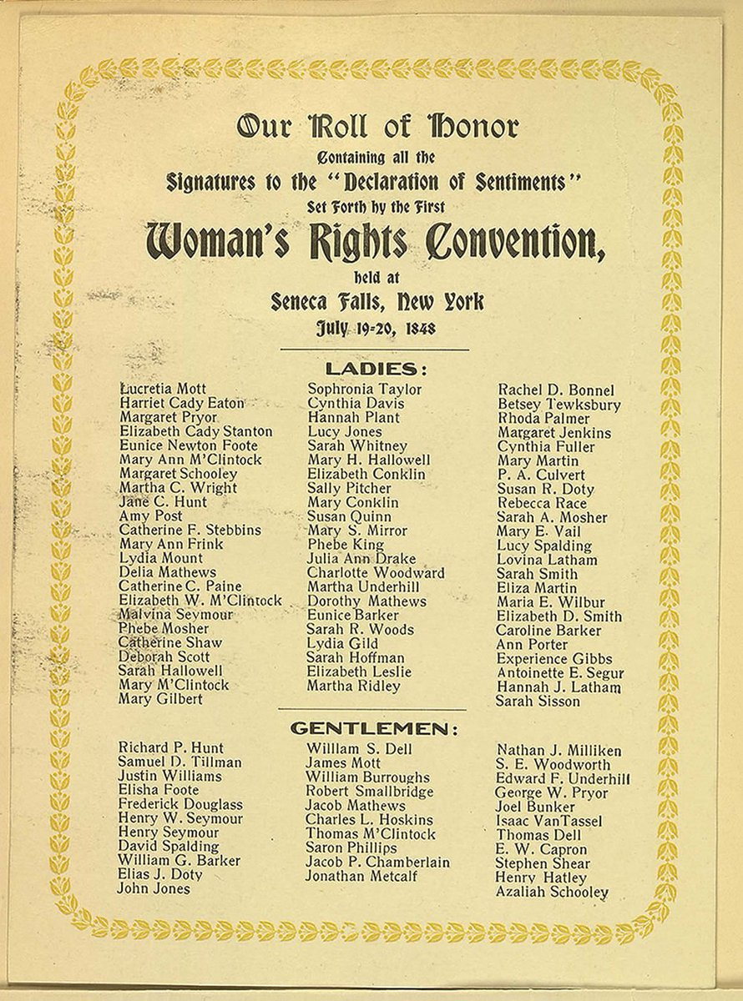
11 Resolutions all passed unanimously
Except #9-the most controversial:
That women should be allowed to vote.
That resolution finally passed, but barely.
Notes:
In addition to the Declaration of Sentiments, 11 resolutions were also presented. Only one was problematic. The idea of giving women the right to vote was so outrageous, even Lucretia Mott feared it would turn people against their cause. It was one thing to say women deserved property rights and rights to their children, but quite another to give women the power to control the laws that governed men. It wasn’t until the esteemed abolitionist, Frederick Douglass, rose to speak in favor of it that enough were persuaded to support the idea and give it the slim margin it needed to pass.

Slide 16
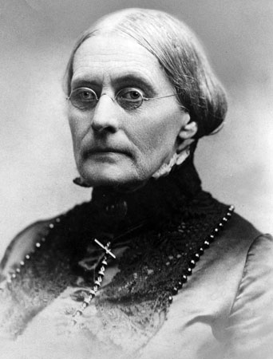
Susan B. Anthony
“There is not a woman born who desires
to eat the bread of dependence.”
Notes:
The Seneca Falls Convention set off a wave of women’s right’s meetings and also considerable outrage. But the movement lacked any central organization. Although she continued to write, Elizabeth Cady Stanton, tied down with her growing young family, was unable to leave home to spread the doctrine of women’s rights. In 1851, however, she was introduced to an unmarried woman four years her junior who was also an ardent supporter of the cause: Susan B. Anthony.
Anthony had been actively working in the temperance and abolitionist movements. She was a natural politician, successfully circulating petitions and courageously speaking in public even though she was sometimes pelted by eggs and even burned in effigy.

Slide 17
Joining forces
”The right is ours. Have it we must. “Failure is impossible.”
Use it we will.”
Notes:
The partnership between Elizabeth Cady Stanton and Susan B. Anthony marked the real beginning of the women’s suffrage movement. Cady Stanton said, “I forged the thunderbolts. She fired them.”
They were unlikely allies. Elizabeth Cady Stanton had been born in 1815 into a family of tradition and privilege in New York state. Her strict father was respected judge. Elizabeth was one of eleven children, only four of whom, all girls, survived to adulthood. Her father once said to her, “I wish you were a boy.” She set her sights on fulfilling the destiny her deceased brothers could not. She begged her father to allow her to pursue her education at a time when no college would admit women. Her father opposed the idea, thinking an education would make her unattractive to suitors, but he finally agreed to send her to a rigorous seminary where she completed her studies in 1833. Through a cousin, she became involved with the abolitionist movement and met her future husband, Henry Stanton. When they married, she insisted on striking the word “obey” from her marriage vows.
Susan B. Anthony was born four years after Elizabeth in Massachusetts and was raised a Quaker. Unlike Elizabeth’s father, Susan’s father supported and encouraged her education, and enrolled her in a Quaker boarding school in Philadelphia. When her father’s business floundered, Susan took a job as a teacher and moved up to a position as head of a female academy. Ten years later, her father had reestablished a successful business in Rochester, NY and offered to let Susan run the family farm there. She relocated to western New York state which had become a center for anti-slavery and temperance reformers. She took to it immediately, and decided activism would be her life’s work. Although she had many suitors, she refused to marry and relinquish control over her life to a husband.
These two women led vastly different lives and had some profound disagreements, but remained lifelong friends for the next fifty years with Cady Stanton assuming the role of the philosopher and writer, and Susan B. Anthony the activist and practical tactician.
During the years following the Seneca Falls Convention, they continued to work together on temperance, divorce reform, coeducation, married women’s property rights, dress reform, and equal pay for equal work. Elizabeth’s attorney husband was frequently absent, so Susan lived at the Stanton home for a time, helping with the household and child rearing duties while Elizabeth put her reformist ideas to pen and paper.

Slide 18
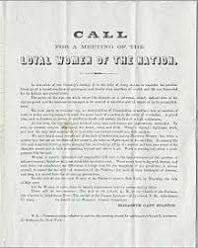
Civil War
The Women’s Loyal National League
Notes:
When the Civil War broke out, Elizabeth Cady Stanton and Susan B. Anthony made a strategic decision: they would suspend their campaign for women’s rights and focus all their efforts in support of the first great cause they had fought for: the abolition of slavery. They formed the Women’s Loyal National League which grew to 5000 members and conducted the largest petition drive in the nation’s history, gathering over 400,000 signatures in support of the abolition of slavery. The Women’s Loyal League provided its leaders a blueprint for the women’s rights movement that would follow, and their efforts on behalf of a grateful nation, they believed, would be richly rewarded by the achievement of rights for women as well as blacks. They were wrong.

Slide 19
The reconstruction amendments
^{Section 1: 13th Amendment:}
“Neither slavery nor involuntary servitude, except as a punishment for crime whereof the party shall have been duly convicted, shall exist within the United States, or any place subject to their jurisdiction.”
Section 2: 14th Amendment:
Representatives shall be apportioned among the several States according to their respective numbers, counting the whole number of persons in each State, excluding Indians not taxed. But when the right to vote at any election for the choice of electors for President and Vice-President of the United States, Representatives in Congress, the Executive and Judicial officers of a State, or the members of the Legislature thereof, is denied to any of the male inhabitants of such State, being twenty-one years of age, and citizens of the United States, or in any way abridged, except for participation in rebellion, or other crime, the basis of representation therein shall be reduced in the proportion which the number of such male citizens shall bear to the whole number of male citizens twenty-one years of age in such State.
Section 1: 15th Amendment:
The right of citizens of the United States to vote shall not be denied or abridged by the United States or by any state on account of race, color, or previous condition of servitude.
Notes:
The 14th amendment used the word “male” for the first time in the Constitution. Stanton and Anthony were outraged and refused to support it. Anthony said, “I would rather cut off my right hand than ask the ballot for the black man and not the woman.” The prominent abolitionist Wendell Phillips told the women to be patient. “This hour belongs to the negro,” he said. There should be one idea for a generation: first: negro suffrage, then temperance, and then, maybe, women’s suffrage. The 13th and 14th amendments were ratified by 1868.

Slide 20
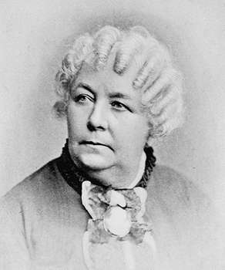
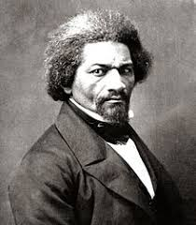
Equal Rights Association Convention in 1869 “The Negro’s Hour”
“Sambo, like the immigrant newcomer, isn’t ready for the vote.” – Elizabeth Cady Stanton
"I do not see how anyone can pretend that there is the same urgency in giving the ballot to woman as to the negro.
With us, the matter is a question of life and death, at least in fifteen States of the Union.” –Frederick Douglass
Notes:
In 1866, Stanton and Anthony formed The Equal Rights Association dedicated to universal suffrage. At the convention in 1869, they were working to get the word “sex” added to the language of the 15th amendment. That proved to be a bridge too far, and Stanton expressed her outrage on the convention floor, only to be soundly rebuked by Frederick Douglass. Many were appalled at Stanton’s comments and voted overwhelmingly in favor of the 15th amendment.

Slide 21
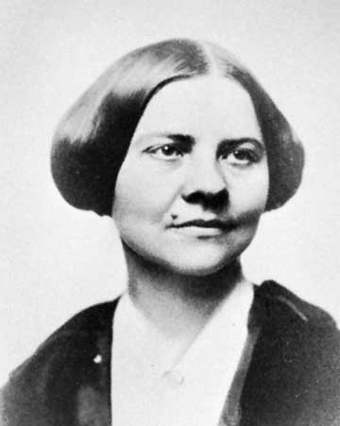
Split in the movement
National Women’s Suffrage Association American Women’s Suffrage Association
Come, come, my conservative friend, wipe the dew off your spectacles, and see that the world is moving. –Elizabeth Cady Stanton
There never will be complete equality until women themselves help to make laws and elect lawmakers. –Susan B. Anthony
But I do believe that a woman's truest place is in a home, with a husband and with children, and with large freedom, pecuniary freedom, personal freedom, and the right to vote. - Lucy Stone
-
Notes:
Stanton and Anthony concluded that the cause of women’s suffrage could only be accomplished by women themselves. They formed the National Woman’s Suffrage Association which would focus on a broad spectrum of women’s rights and a federal constitutional amendment. Men were not permitted to be officers. Lucy Stone Blackwell from Boston, a more conservative activist, formed a competing organization called the American Woman’s Suffrage Association which was solely focused on women’s suffrage, open to all, and worked on individual state constitutional amendments. This division set the movement back considerably.

Slide 22
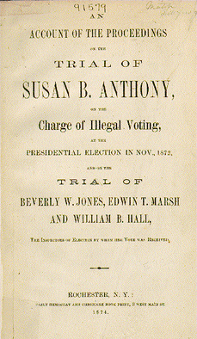
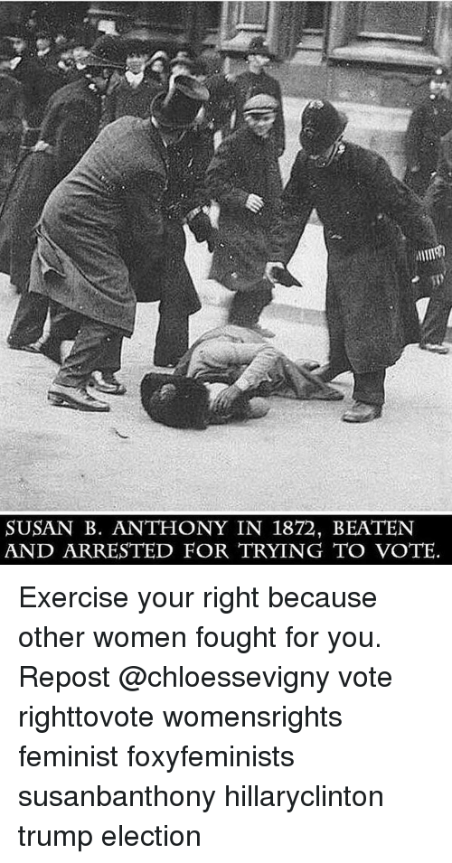
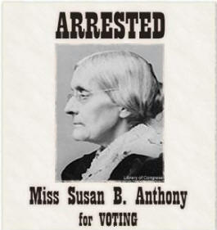
The challenge
“Resistance to tyranny is obedience to God.” – Susan B. Anthony
Notes:
In the presidential election of 1872, the newly formed NWSA, citing a broad interpretation of the 14th amendment, decided to test the waters, and recruited about 150 women to try to vote. They fully expected to be arrested, and hoped to bring their case to the Supreme Court. Susan B. Anthony was arrested and insisted on being put in handcuffs. Just as she hoped, her trial earned widespread publicity. The judge made the mistake of asking her if she’d like to address the court. He got quite an earful. When she was told to sit down, she just kept going and was ultimately fined $100 plus court costs or face jail time. The fine was never collected and no jail time was imposed. Her case didn’t make it to the Supreme Court, but another filed by Virginia Minor from Missouri did. The court ruled in 1875 that the U.S. Constitution did not grant the right to vote if a state constitution prohibited it.

Slide 23
The West leads the way
Notes:
In the late 19th century, many western states joined the union, granting women’s suffrage in their state constitutions. It seemed the natural order of things where the rigors of frontier life didn’t allow women the luxury to simply care for hearth and home. They had to work alongside their husbands to survive. Wyoming was the first state to enter the union with full women’s suffrage in 1890. Colorado held a referendum on the question in 1893. Carrie Chapman Catt who would later steer the movement to final ratification of the 19th amendment, was enlisted to support the effort. She traveled over 1000 miles of the state, once riding in a railroad side car to get to a meeting on time. She lectured with her “voice like a foghorn”, and the referendum passed with 55% of the vote. Colorado became the second women’s suffrage state in 1893. Utah and Idaho followed in 1896. After the turn of the century and the advent of the Progressive Movement led by Teddy Roosevelt, several other states followed: Washington – 1910, California – 1911, Arizona, Kansas, and Oregon in 1912, Montana and Nevada in 1914, New York in 1917, Michigan and Oklahoma and South Dakota in 1918.

Slide 24
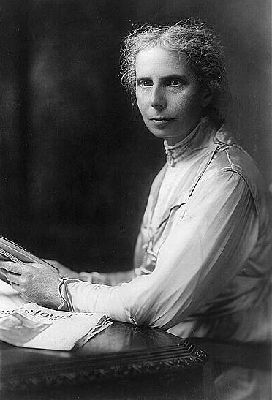
reconciliation
“Justice is better than chilvary
if we cannot have both.”
- Alice Stone Blackwell
Notes:
Toward the end of the 19th century, Alice Stone Blackwell, daughter of Lucy Stone Blackwell, worked to pass a women’s suffrage referendum in Boston. For the first time, organized opposition became significant. Many women believed in the “Cult of Womanhood” which espoused that women’s real power came from their femininity and devotion to home and family. Dirtying their hands with politics was frowned upon. The referendum failed badly, and spurred a more organized “anti” movement nationwide, supported by women but also business leaders who feared women’s votes would force changes in labor laws, and liquor lobbyists who equated women with the temperance movement. To strengthen the suffragist organization, Alice Stone Blackwell worked to reconcile the two competing national women’s suffrage associations into one: The National American Women’s Suffrage Association (NAWSA).

Slide 25
Exclusion
Notes:
For the white middle and upper-class women who led the women’s suffrage movement, black women’s suffrage was a thorny problem. Most viewed black women’s suffrage as a race rather than a gender issue. Some remained bitter after being cast aside in favor of black men in the reconstruction amendments. The comprehensive History of Women’s Suffrage written by Elizabeth Cady Stanton and Susan B. Anthony among other founding members of the movement, scarcely mentions black women suffragists despite the fact the many African American Club Women’s organizations worked tirelessly for the cause. Some white suffragists spoke out against enfranchising “murderous Indians” and “ignorant, illiterate immigrants”. Some leaders even argued that enfranchising white women in the south would aid in the perpetuation of Jim Crow laws. As the time drew near to final ratification, white suffragists made the cynical political calculation to sacrifice southern black women’s rights to southern segregationists’ votes. (See notes at the end for more information on voting restrictions.)

Slide 26
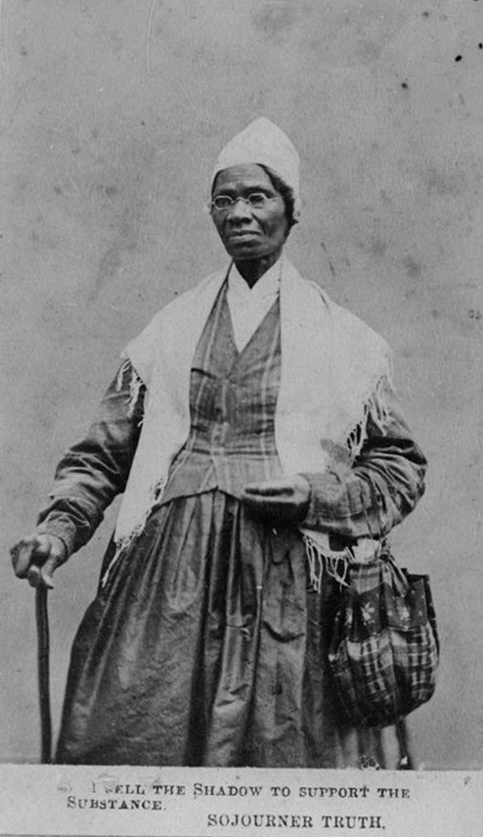
“There is a great stir about colored men
getting their rights, but not a word about
the colored women; and if colored men get their rights,
and not colored women theirs, you see,
the colored men will be masters over the women,
and it will be just as bad as it was before.”
– Sojourner Truth
Notes:
There were many notable black women suffragists, the earliest of whom was Sojourner Truth. Born a slave in 1797 in a Dutch settlement of New York State, her slave name was Isabella Baumfree. Dutch was her first language. She was sold four times, bore five children, and gained her freedom with the help of abolitionists in 1827. She never learned to read or write, but dictated books, and devoted her life to preaching and speaking out for the causes of abolition, temperance, and women’s suffrage. She claimed that her new name, Sojourner Truth, came to her in a revelation which compelled her to become an itinerant preacher. In her most famous speech at an 1851 women’s rights convention in Ohio she said, “That man over there says women need to be helped into carriages and lifted over ditches, and to have the best place everywhere. Nobody ever helps me into carriages or over puddles, or gives me the best place – and ain’t I a woman?”

Slide 27
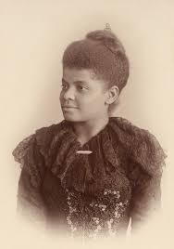
“What becomes a crime deserving capital punishment when
the tables are turned is a matter of small moment
when the negro woman is the accusing party.”
- Ida B. Wells-Barnett
Notes:
Ida B. Wells was born a slave in 1862. When her parents died of yellow fever in 1878, she was forced to drop out of school and became a teacher in order to support her siblings. Eventually, she became a journalist, and published a pamphlet, “Southern Horrors: Lynch Law in all its Phases”. When the Memphis office where she worked was firebombed, she fled to Chicago where she met and married the lawyer Ferdinand Barnett. It wasn’t long before she imbedded herself deeply into the African American political community in Chicago and even ran, although unsuccessfully, for the U.S. Senate. She founded the black Chicago Alpha Women’s Suffrage Club and traveled to Washington, D.C. to march in the 1913 suffrage parade, proudly representing her Alpha Club sisters as part of the Illinois delegation. When she arrived there, the parade organizers told her that she would have to march at the end of the parade with the “colored delegation” otherwise southern white suffragists would refuse to march. Ida waited on the sidelines until the white Illinois suffragists passed by, and defiantly jumped in to march in step with them.

Slide 28
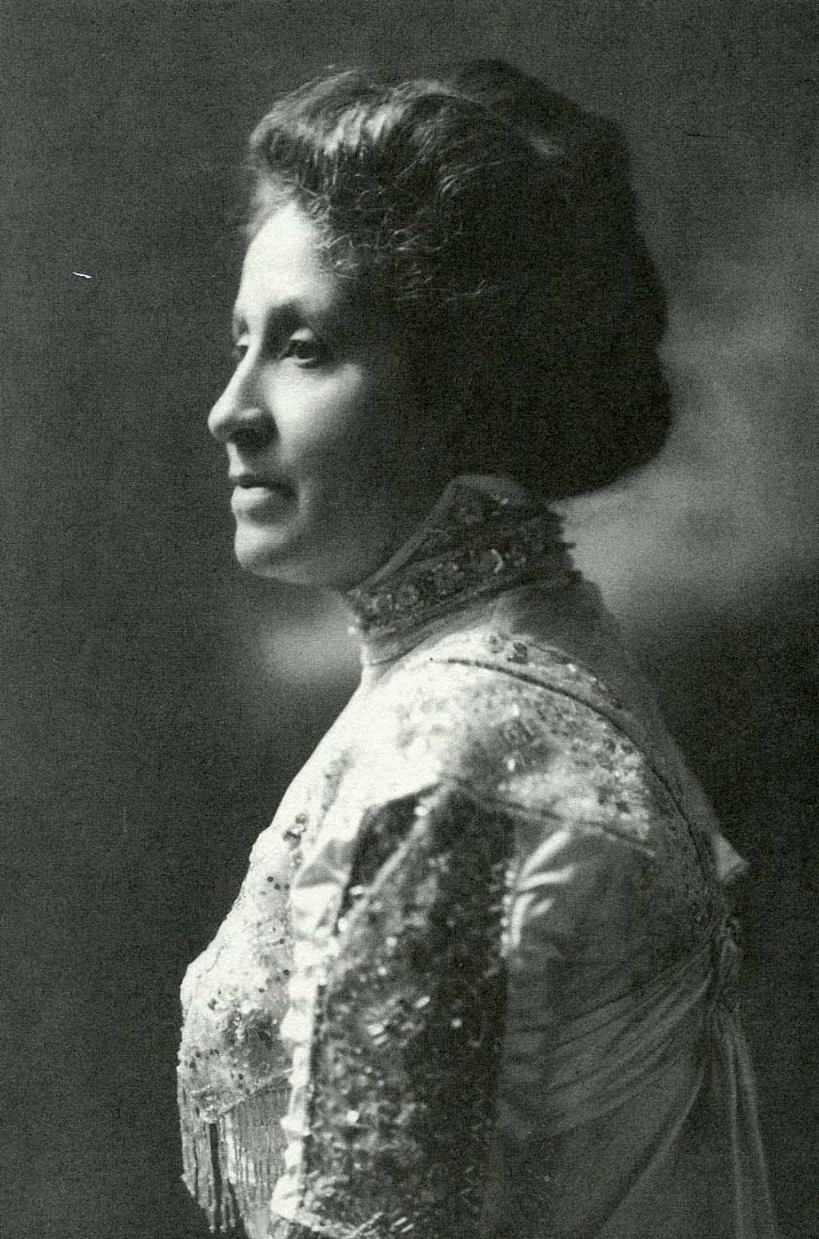
”A white woman has only one handicap to overcome-that of sex.
I have two – both sex and race…Colored men have only one –
that of race. Colored women are the only group in this country
who have two heavy handicaps to overcome, that of race as well
as that of sex.”
- Mary Church Terrell
Notes:
Mary Church was the daughter of former slaves whose father became one of the first southern African American millionaires. She was the rare black woman to grow up in a home of privilege in the south. She obtained a Master’s degree from Oberlin College, became a teacher, and married Robert H. Terrell, a school principal at the M Street Colored High School in Washington, D.C. They were a power couple in the black community there. Mary was poised, dignified, and light-skinned enough to pass for a white woman. She was propelled into activism at an early age when a close friend was lynched for competing with white businesses, and she joined in Ida B. Wells’ anti-lynching campaign. But Mary always advocated for a more moderate path to equality. She believed black people would improve their lot through education, work, and activism. “Lifting as we climb” became the motto of the National Association of Colored Women she helped to found. She was also a founding member of the NAACP, and the first black woman to join the AAUW. Due to her wealth and status, she was accustomed to travel abroad, and in 1904, she was asked to deliver a speech about the lives of African American women to the International Council of Women in Berlin. She had meticulously prepared her speech in advance, but when delegates complained that all the Americans were speaking only in English, she revised her remarks overnight, and delivered her speech in flawless German which she spoke fluently along with Italian and French. Her pleas to her fellow white suffragists seemed to fall on deaf ears, however. She implored them, “My sisters of the dominant race, stand up not only for the oppressed sex, but also for the oppressed race.”

Slide 29
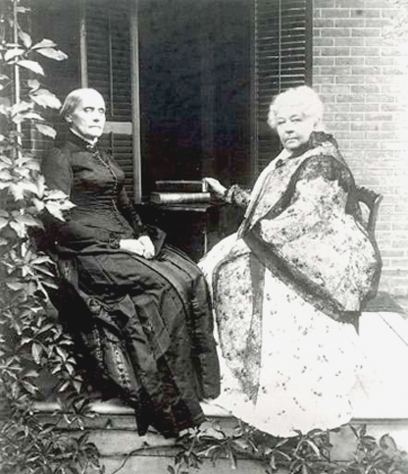
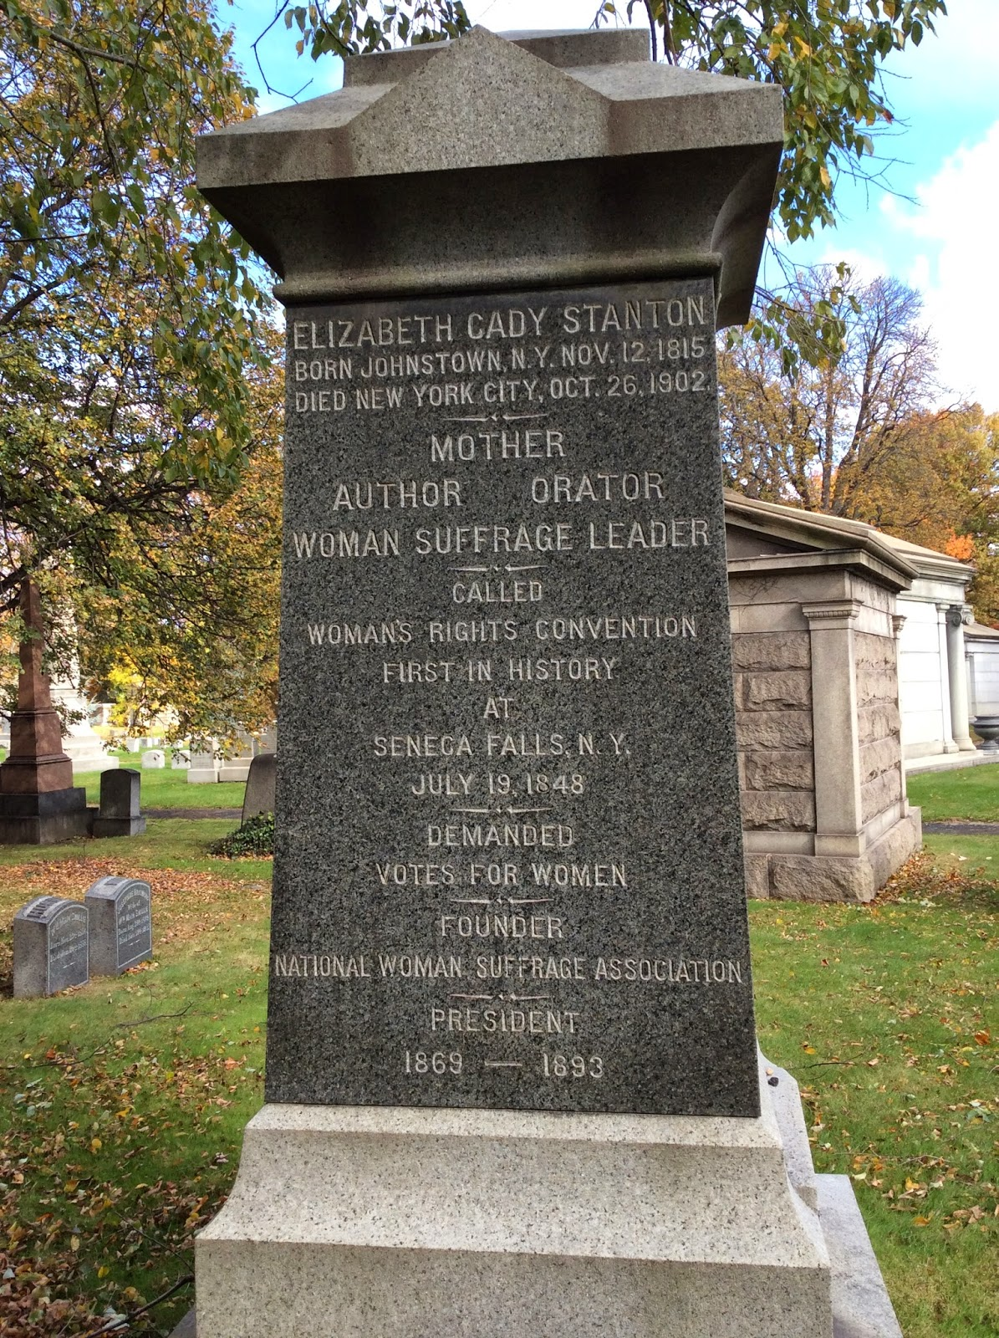
The torch is passed
Notes:
Neither Elizabeth Cady Stanton nor Susan B. Anthony lived to see women’s suffrage become the law of the land. Stanton died at age 86 from heart failure in 1902. In her later years, she was in poor health, obese, and generally ostracized by the suffragists for her radical views. At her funeral, she requested that Susan B. Anthony’s portrait be placed upon her coffin. Susan B. Anthony remained active nearly to the end of her life, and celebrated her 80th birthday at the White House at the invitation of President McKinley. She also died at age 86 of heart failure four years after Stanton in 1906, but enjoyed widespread admiration for her lifelong devotion to the cause of women’s suffrage. Over 10,000 mourners attended her funeral. Both women are buried in New York state.

Slide 30
New energy for a new century
Notes:
With the founding mothers gone, the movement was carried forward by an anointed new generation: Harriet Stanton Blatch, daughter of Elizabeth Cady Stanton, Anna Howard Shaw, an ordained Methodist minister and medical doctor, and Carrie Chapman Catt who had been personally chosen by Susan B. Anthony as her successor. As the twentieth century dawned, women’s roles in society were rapidly changing. More and more women were working outside the home. World War I brought urgent demands for women’s labor to support the military effort. Membership in labor unions was surging and becoming integrated with the women’s suffrage movement. By 1910, women in 5 western states were voting, and by 1918, another 15 states would follow, now making women’s votes a significant consideration for politicians. Across the pond, British suffragists were beginning to inspire the new generation of American women’s rights leaders to adopt more militant tactics. Suddenly, the American women’s suffragist movement went public with parades, pageants, public speeches, and picket lines. By 1910, the new leaders of the movement seemed out of patience and their sense of urgency was on full display.

Slide 31
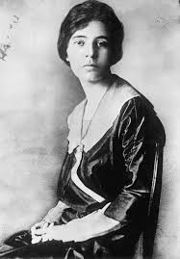
The radical wing
“I never doubted that equal rights was the right
direction. Most reforms, most problems are complicated.
But to me, there is nothing complicated about equality.”
- Alice Paul
Notes:
Alice Paul was born into a progressive Quaker family in 1885. Her mother was a suffragist and brought her to meetings as a young girl. She earned a degree from Swarthmore College, a Quaker school co-founded by her grandfather, then went on to earn a Master’s degree in sociology from Columbia University, and a PhD from the University of Pennsylvania. In 1907, she went to England to study sociology and got involved in the more radical tactics of the British suffragists, dubbed “suffragettes”. (This once derogatory term became a badge of honor in time.)
While in England, she met Lucy Burns. Both participated in demonstrations in Britain, were sent to prison and staged hunger strikes. Together Paul and Burns would forge the new generation of young suffragists into a formidable force. Alice Paul took charge of the Washington, D.C. chapter of the NAWSA, but would soon part ways with that organization to form the National Woman’s Party with Lucy Burns. They chose to adopt the tactics of the more radical British suffragist sisters, but as a Quaker, Paul rejected violence, opting for civil disobedience instead.

Slide 32
1913 parade in Washington, DC
Notes:
In just nine weeks, Alice Paul organized a Woman Suffrage Procession to be staged in Washington, D.C. on the eve of Woodrow Wilson’s inauguration. Headed by “the most beautiful suffragette” Inez Millholland, clad in flowing white robes and mounted on a white horse, the parade was rich with majestic symbolism. It attracted 10,000 marchers and half a million spectators. It was supposed to be a dignified affair, but the crowd became unruly, and the police stood by and did nothing. The cavalry had to be called in to keep order. As a result, when Woodrow Wilson arrived at the train station that afternoon, the capital city of the country he would soon govern was otherwise engaged, and there were scant crowds there to greet him. A few days later when Paul met with Wilson to urge his support for a women’s suffrage amendment, she was rebuffed. He would support states granting suffrage individually, but not a federal constitutional amendment.

Slide 33
The silent sentinels
Notes:
In January, 1917, Paul organized the “silent sentinels” who picketed in front of the White House. “Mr. President, how long must women wait for liberty?” read one banner. On another, the President was referred to as “Kaiser Wilson”. Paul also staged demonstrations called “Watchfires of Freedom” in which Wilson’s speeches were publicly burned. With American boys fighting “over there” in World War I, public sentiment turned against the women protesters who were branded as unpatriotic, even treasonous. These demonstrations rattled the leaders of the NAWSA who feared the fragile political coalition of support they were building would be jeopardized.

Slide 34
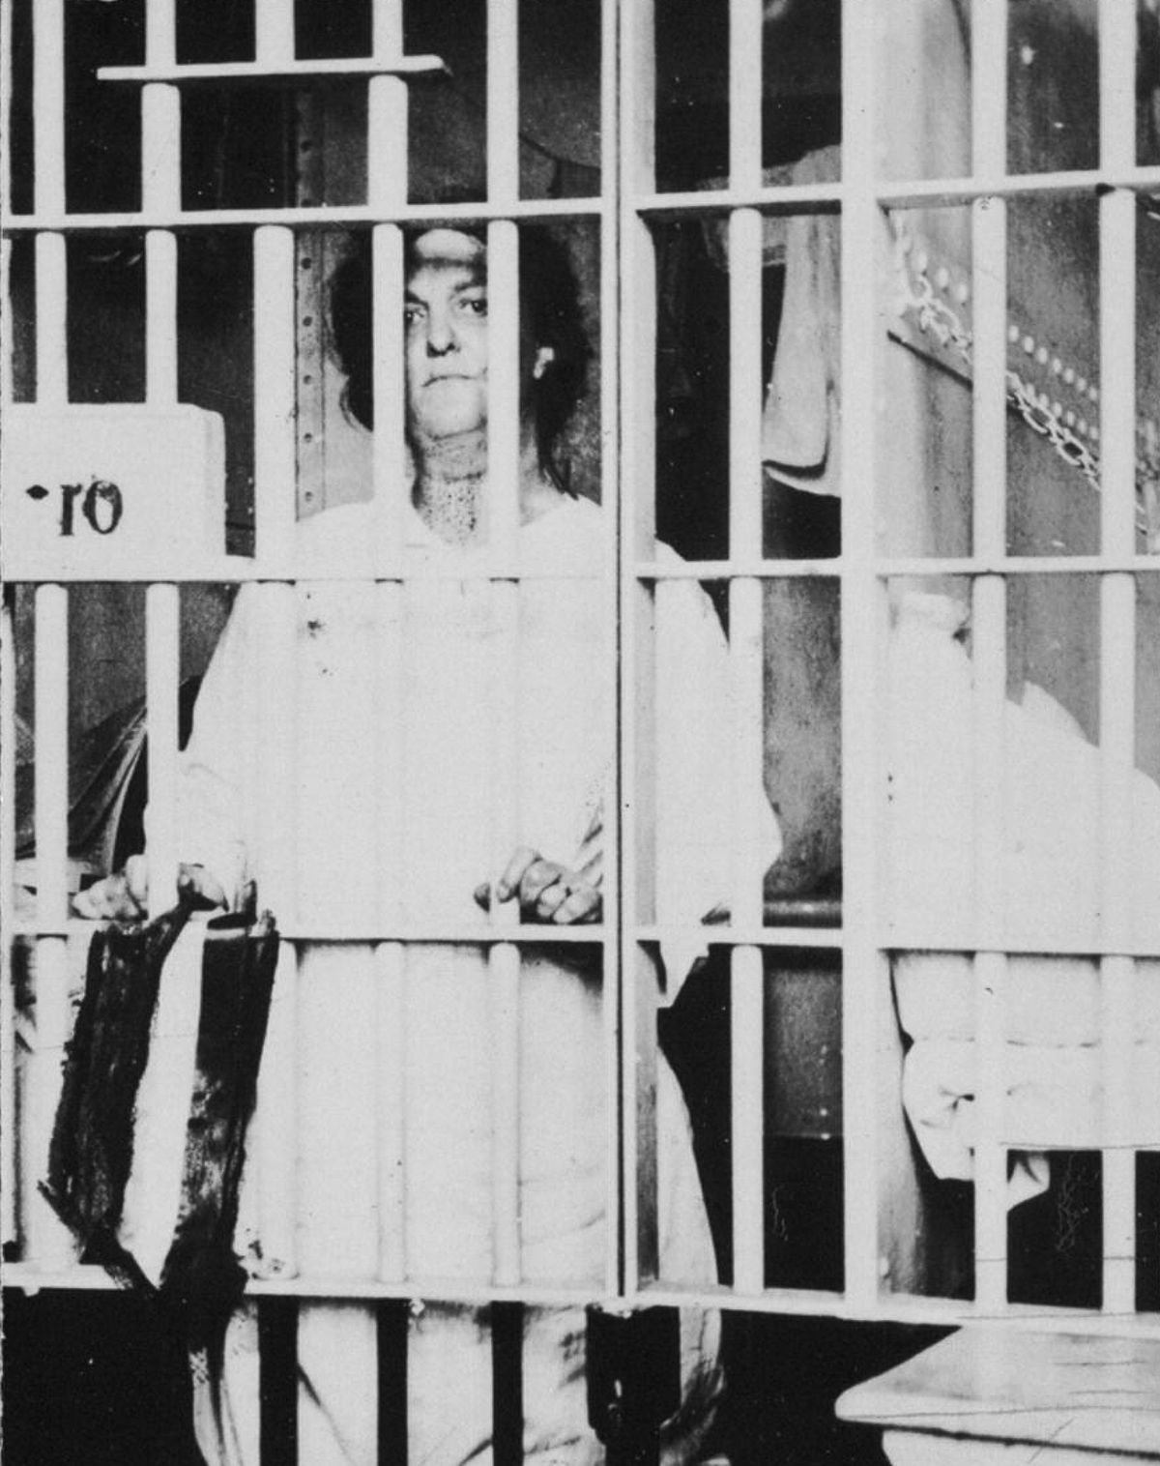
Night of Terror
Notes:
The Silent Sentinels endured verbal and physical attacks. To keep the peace, Wilson ordered arrests on the trumped-up charge of “obstructing traffic”. The women were hauled off to the Occoquan Workhouse in Virginia. They endured deplorable living conditions there. On the night of November 14, 1917, 33 women prisoners were subjected to torture and beatings. Alice Paul led her fellow prisoners in a hunger strike which led to violent force-feedings. Paul was hauled off in a strait jacket to an insane asylum and examined by a psychiatrist. He could find nothing wrong with her sanity.
When the picketing ended, about 500 women had participated and 170 had been sent to prison. As word of the mistreatment of the women prisoners got out, it sparked an outcry of sympathy, and public sentiment began to turn in favor of the suffragists’ cause. The following year, Wilson finally offered his support of the constitutional amendment, although his change of heart was primarily due to the relentless persuasion that came from Carrie Chapman Catt.

Slide 35
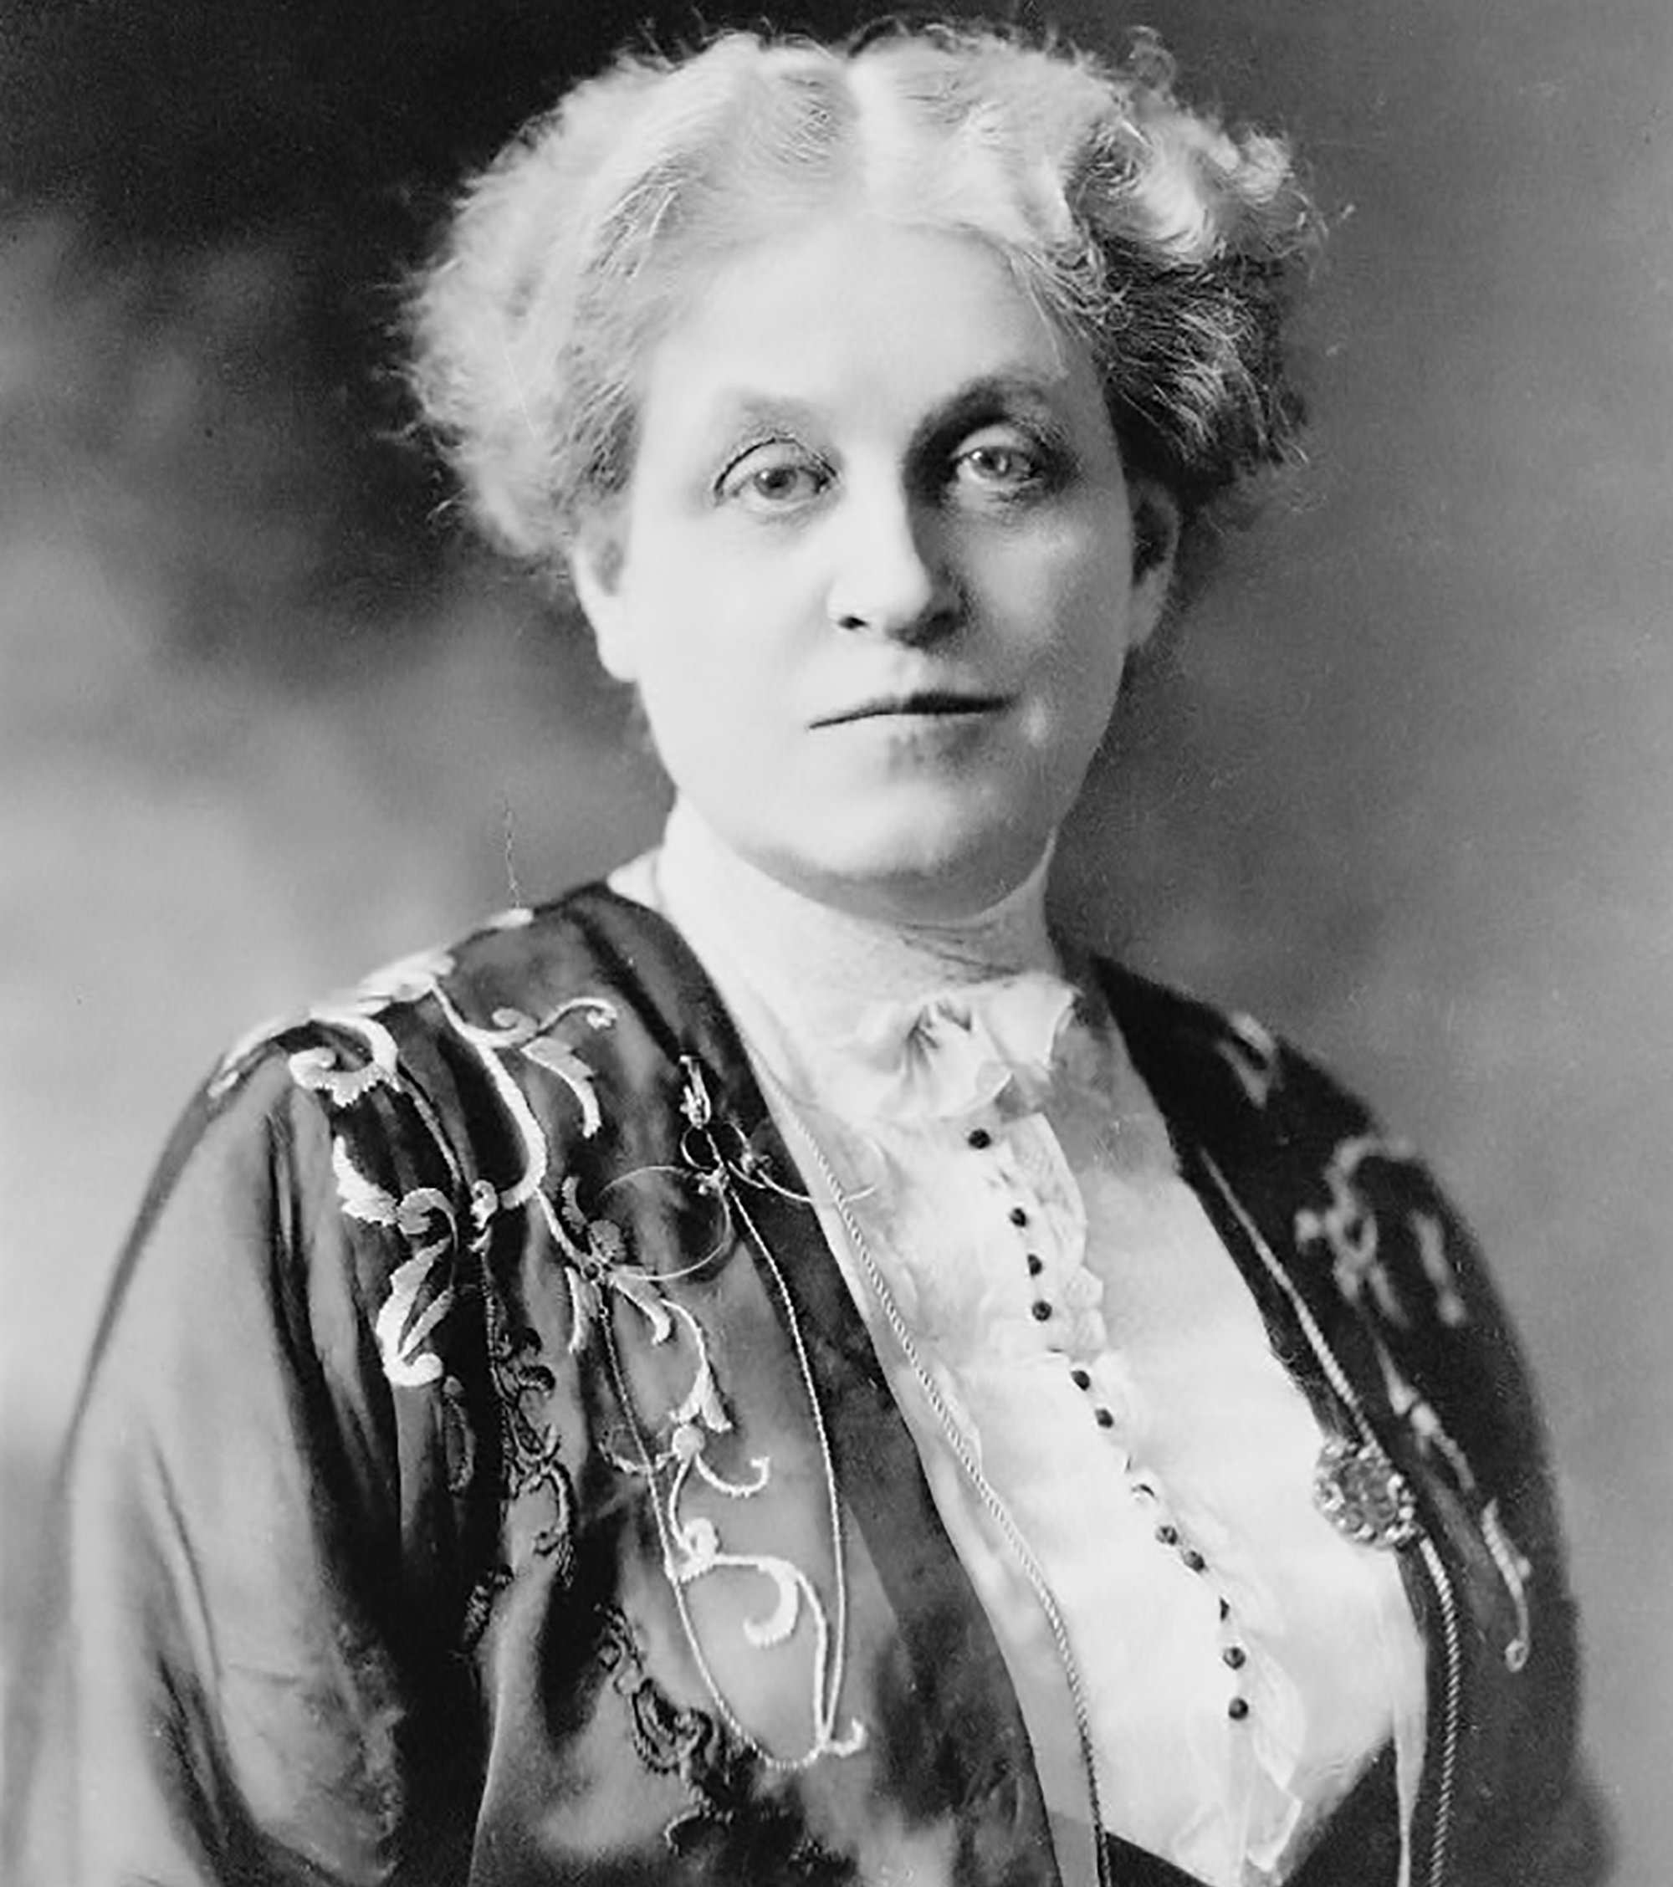
The general: Carrie Chapman Catt
”There will never be a true democracy
until every responsible and law-abiding
adult in it, without regard to race, sex, color
or creed has his or her own inalienable and
unpurchasable voice in government."
Notes:
On the more moderate front of the fight for women’s suffrage was the NAWSA, headed by Carrie Chapman Catt. Born in Ripon, Wisconsin, she grew up in Iowa where she financed her education by washing dishes and teaching during school breaks. In short order, she became a Superintendent of Schools in Mason City, Iowa. She married Leo Chapman in 1885, but he died a year later of typhoid fever. Her second husband, George Catt, was a wealthy engineer who encouraged her suffrage work, and her marriage afforded her the time and money she needed to devote herself to the cause. She quickly rose through the ranks of the Iowa Women’s Suffrage Association, recognized as a powerful speaker and by age 30, the movement’s greatest organizer. She took the reins of the NAWSA from Susan B. Anthony in 1900, but resigned in 1904 to care for her ailing husband. She returned to steer the NAWSA as president on the home stretch from 1915 until 1920, increasing the organization’s respect, membership and its coffers dramatically.

Slide 36
The Winning Plan
Notes:
Catt’s “winning plan” was unveiled in 1916. It called for simultaneously working for suffrage in state legislatures as well as at the federal level. The logic was that once a critical mass of enfranchised women was achieved by the states, a federal amendment was inevitable. The plan worked just as Catt had envisioned. In 1917, the state of New York finally adopted women’s suffrage. This seemed to break the log jam of opposition to a federal amendment. Both the NAWSA and Alice Paul’s National Women’s Party then poured their efforts into moving the Congress. Carrie Chapman Catt hired Maud Wood Park as chief lobbyist for the NAWSA. Alice Paul’s NWP instructed its lobbyists on the “care and feeding” of congressmen and senators. (It should be noted that by this time there was ONE Congresswoman, Jeannette Rankin, elected in 1916 from Montana.) But still, President Wilson would not publicly declare his support.

Slide 37
The Susan B. Anthony Amendment
"The right of citizens of the United States to vote shall not be denied or abridged by the United States or by any State on account of sex. Congress shall have power to enforce this article by appropriate legislation."
Notes:
Such a simple, straightforward statement, yet it had taken 144 years since the nation’s founding to gain acceptance.
The fight to pass the federal amendment in Congress was a dramatic, 18-month long effort. The first vote was taken in the House on June 10, 1918. The margin was so close that some representatives had to be summoned from their sickbeds, one was carried in on a stretcher, and one left his wife’s deathbed (at her urging) to cast their votes. The bill was passed. The Senate proved a much tougher fight. Carrie Catt urged Wilson to encourage support for the bill, but she thought the statement he drafted wasn’t strong enough, so she wrote another and he signed it. The vote did not achieve the necessary 2/3 support. At that point, Catt put in motion a “plan for making trouble”. The NWASA would cast aside its non-partisan mantle, and actively work to unseat Senators who opposed women’s suffrage. Meanwhile Alice Paul’s National Women’s Party shifted its public protests into high gear culminating with a nationwide campaign to sway public opinion called “The Prison Special”. Women who had been jailed for protesting traveled across the country by train, speaking to over 50,000 people. The result was an avalanche of letters of support sent to Congress from constituents. All of this was taking place against the backdrop of delicate peace negotiations in Europe at the end of World War I and the deadly Spanish flu pandemic. But by the time the 66th Congress took up the question again in June of 1919, public support was overwhelming, and it easily passed both houses of Congress.

Slide 38
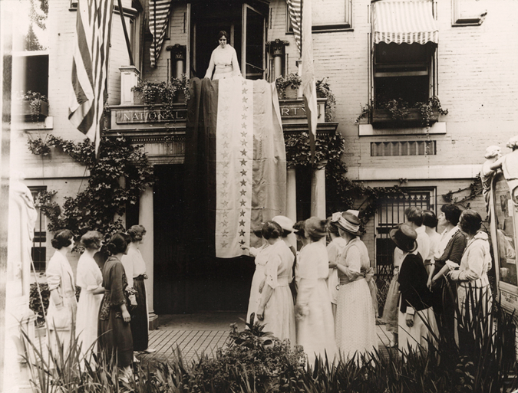
Victory at last
Notes:
As state ratifications progressed, Alice Paul began sewing her “victory banner” adding another star for each new state. Wisconsin was the first. Delaware was supposed to be the final state to ratify, but unexpectedly, the effort failed there. The next target was Tennessee.
By the summer of 1920, the 19th amendment was one state short, and the entire political apparatus of the country, the “suffs”, the “antis”, the special interest lobbyists, the Republicans and the Democrats in the midst of a presidential election campaign, all descended on Nashville, Tennessee for the final push. When the fateful day arrived for the vote, the red rose of the “antis” dominated in the lapels of the state assemblymen. It looked as if the suffragists were one vote short. As the roll call proceeded, a freshman legislator named Harry Burn switched his vote at the last minute, following the admonition of his mother: “Don’t forget to be a good boy and help Mrs. Catt put the RAT in ratification.” That one vote on August 18, 1920 changed the lives of half the population of the United States, and Alice Paul was able to add the 36th and final star to her victory banner. The amendment was certified on August 26, 1920, Women’s Equality Day. Despite the fact that Alice Paul and Carrie Chapman Catt had devoted their lives to the cause of women’s suffrage, they were never able to see eye-to-eye about how to achieve it, so in order to avoid a public spectacle, neither was invited to the final signing ceremony on that day. All fifty states did eventually ratify, but, unbelievably, it took until 1984 for the last one: Mississippi.

Slide 39
Notes:
These were the most important leaders of the women’s suffrage movement and the distinct roles they fulfilled:
Lucretia Mott was its moral force.
Elizabeth Cady Stanton was its philosopher.
Susan B. Anthony was its organizer.
Lucy Stone Blackwell was its voice. (It was said she had a voice like a bell).
Alice Paul was its passion.
Carrie Chapman Catt was its political strategist.
(AT THIS POINT, YOU CAN OMIT THE SLIDES PERTAINING TO WISCONSIN AND SKIP TO SLIDE 54 TO FINISH THE PRESENTATION.)

Slide 40
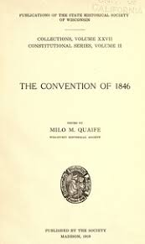
Meanwhile in Wisconsin…
At the Wisconsin Constitutional Convention in
1846 a proposal that the word “male” be omitted
before the word “suffrage” was met with laughter.
Wisconsin entered the union in 1848
without women’s suffrage.
Notes:
At the Wisconsin Constitutional Convention in 1846, delegates wrestled with whether to extend suffrage to black men and / or all women. Those questions proved too difficult to resolve, so Wisconsin entered the Union as the 30th state in 1848 with white male suffrage only, the same year as the Seneca Falls Convention.

Slide 41
Notes:
As early as 1855, national suffrage leader Lucy Stone spoke throughout Wisconsin urging women to petition for the right to vote. In 1856, three suffrage petitions were introduced in the Wisconsin Senate. The first universal suffrage convention was held in Janesville in 1867, and the Wisconsin Woman Suffrage Association was formed in 1869. This picture is of the Oshkosh Equal Suffrage League in the 4th of July float made to look like a sailboat.

Slide 42
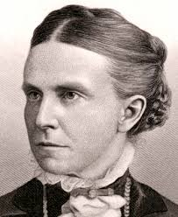
The Wisconsin leaders
Reverend Olympia Brown
The first woman to be ordained a
minister in the US. She was president
of the Wisconsin Woman Suffrage
Association and later worked for
passage of the a federal constitutional
amendment. She lived to cast a vote in
1920 at age 85.
Notes:
Olympia Brown was born in a log cabin in Michigan and was ordained by the Universalist Church in 1863. She became pastor of the Good Shepherd Church in Racine in 1878 and briefly served a congregation in Neenah in 1898. She served as president of the Wisconsin Woman Suffrage Association from 1884 to 1912, and left the ministry is 1887 to devote herself fulltime to the women’s suffrage movement. She was one of Alice Paul's "silent sentinels".

Slide 43
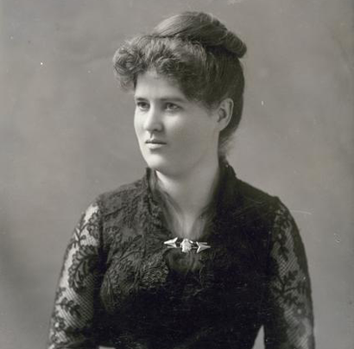
Belle Case LaFollette
The first woman to graduate from
Law School in Wisconsin, she served
as First Lady of Wisconsin and was
an outspoken writer and orator
for women’s right to vote. She traveled
the country between 1915 to 1919
giving speeches in support of women’s
right to vote. She was in the US Senate
gallery in 1919 when the 19th
Amendment was approved.
Notes:
Although her husband, Robert, “fighting Bob LaFollette”, served as a U.S. Congressman and Senator as well as Governor of Wisconsin, Belle was certainly the woman behind the man. She was also a gifted orator, valedictorian of her graduating class, and in addition to helping write many of her husband’s speeches and manage his campaigns, she tirelessly campaigned for women’s rights herself. An ardent pacifist, she helped found the Women’s Peace Party in 1918, and proudly cast her first vote in 1920.

Slide 44
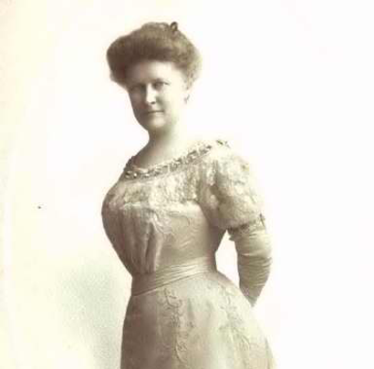
Jesse Jack Hooper
Women’s suffrage leader and
president of the Wisconsin League of
Women Voters; she ran for the US
Senate in 1922 as a Democrat against
Robert LaFollette and won a remarkable
16% of the vote only 2 years after
the passage of the19th amendment. She
was an ardent peace activist as well.
Notes:
Jesse Jack Hooper was born in Iowa, but lived most of her life in Oshkosh. Her causes were many: school reform, public health, an advocate for Native Americans and the Menominee Tribe in particular, and world peace. Two years before her death in 1935, she attended the World Disarmament Conference in Geneva, Switzerland to present a petition signed by a million Americans.

Slide 45
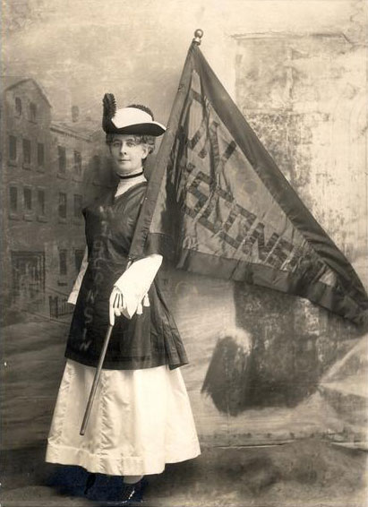
Theodora Winton Youmans
A journalist and active member of the.
women’s club network which subtly
advocated for women’s rights in
society. The articles she wrote provide
some of the best sources on the
Wisconsin Women’s Suffrage Association.
A lifelong Republican, she remained
politically active all her life.
Notes:
When the 19th amendment passed, Theodora Winton Youmans was president of the Wisconsin Woman Suffrage Association.

Slide 46
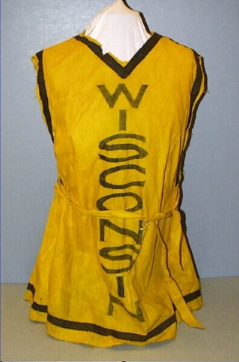
1916 parade in Chicago
Notes:
Undeterred, four years later, a large contingent of Wisconsin women participated in a parade down Michigan Avenue in Chicago during the Republican National Convention. Their yellow tunics became an icon of the Wisconsin suffrage effort.

Slide 47
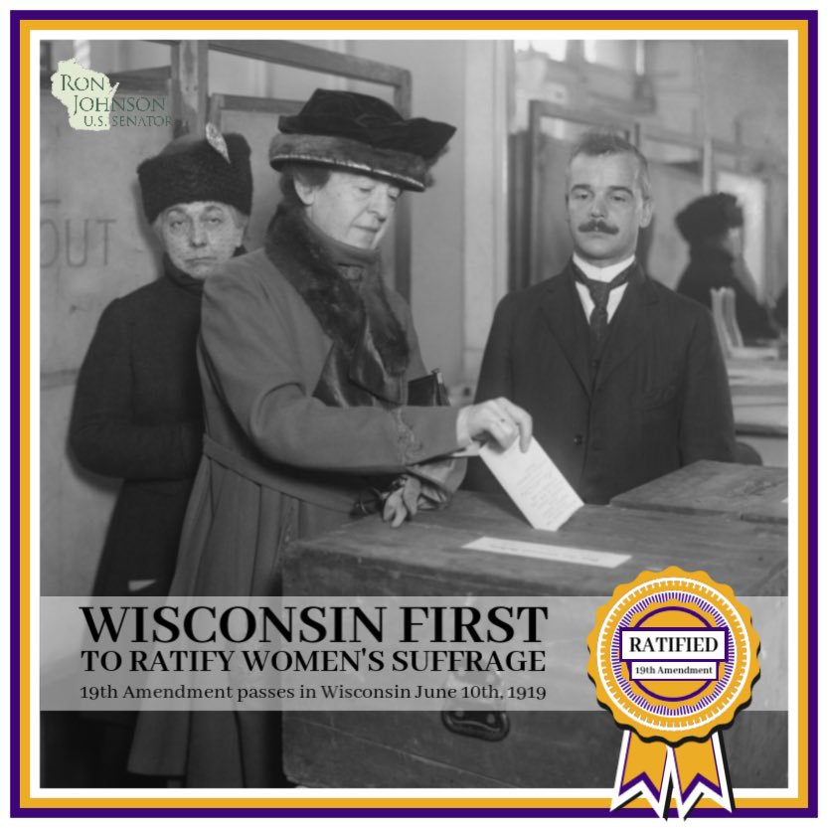
First to ratify!
Notes:
On June 5, 1919, state legislatures received the official papers from the U.S. Congress for the proposed 19th amendment. The amendment now had to be ratified by ¾ of the states in order to become law. The legislatures in Illinois, Michigan, and Wisconsin all ratified the 19th amendment five days later on June 10, 1919. Illinois was the first to vote by a half hour, but before the votes could be certified, the official papers had to be hand-carried across the country to the Secretary of State’s office in Washington, D.C. The 76-year old former Wisconsin Senator David James (father of Ada), was chosen to be the messenger. He arrived in the nation’s capital on June 13 and presented Wisconsin’s official papers. Minutes later, the messenger from Illinois arrived in the same office, but due to an error on the Illinois papers, Wisconsin’s papers were certified first.

Slide 48
Appleton Involvement
Appleton Post Crescent articles were sometimes dismissive of the Suffrage movement or reporting on local lack of interest. Saying things like this in a 1909 article entitled “Roses and Gum May Enter Into Politics”:
“the proposed law would also make a difference in the appearance of candidates, as the handsome man is conceded as having the best chance in the future campaign.”
“It is doubtful, however, if many Appleton women are in favor of the so-called women’s rights principles, and the probabilities are that even in the not expected event of full suffrage being extended to them, not one in ten women would go to polls on election day”
But sometimes more positive:
In 1911 “If any city can boast of an intelligent and progressive womanhood, Appleton is that city.”
In 1920 after Tennessee senate voted to ratify giving hope that their house would as well: “Ratification of the suffrage amendment by the state senate of Tennessee was an agreeable surprise to Appleton women who are eager tor the opportunity to take an active part in politics.”
Important Appleton Women in the Suffrage movement
1916 - Janet Strathern elected temporary chairman of the local branch of the National College Equal Suffrage League organized at Lawrence University.
1914 – Mrs. Rush Winslow elected president of the Outagamie County Political Equality league. (No article was found that gave her first name, only her husband’s.)
Notes:
Appleton Post Crescent articles were sometimes dismissive of the Suffrage movement or reporting on local lack of interest. Saying things like this in a 1909 article entitled “Roses and Gum May Enter Into Politics”:
“the proposed law would also make a difference in the appearance of candidates, as the handsome man is conceded as having the best chance in the future campaign.”
“It is doubtful, however, if many Appleton women are in favor of the so-called women’s rights principles, and the probabilities are that even in the not expected event of full suffrage being extended to them, not one in ten women would go to polls on election day”
But sometimes more positive:
In 1911 “If any city can boast of an intelligent and progressive womanhood, Appleton is that city.”
In 1920 after Tennessee senate voted to ratify giving hope that their house would as well: “Ratification of the suffrage amendment by the state senate of Tennessee was an agreeable surprise to Appleton women who are eager tor the opportunity to take an active part in politics.”
Important Appleton Women in the Suffrage movement
1916 - Janet Strathern elected temporary chairman of the local branch of the National College Equal Suffrage League organized at Lawrence University.
1914 – Mrs. Rush Winslow elected president of the Outagamie County Political Equality league. (No article was found that gave her first name, only her husband’s.)

Slide 49
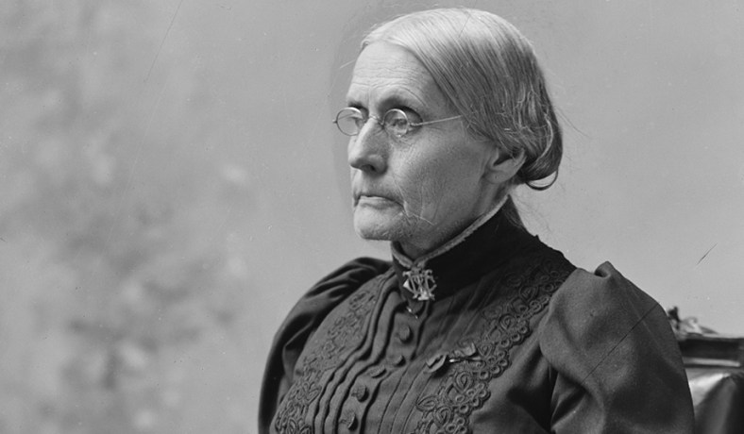
“Oh, if I could live another century and see the fruition of all the work for women! There is so much yet to be done.” -Susan B. Anthony
Notes:
As soon as the 19th amendment was certified on August 26, 1920, Alice Paul turned her attention to an Equal Rights Amendment. It was first proposed in 1923. In 1943, it was renamed "The Alice Paul Amendment". It was introduced every year in Congress until it finally passed in 1972.
It still remains one state short of final ratification. Alice Paul advocated for a national women’s political party to focus its efforts on furthering women’s rights.
Six months before the 19th amendment was certified, Carrie Chapman Catt founded The League of Women Voters in 1920. The new organization was established as a “mighty political experiment” designed to help the newly enfranchised women carry out their civic responsibilities. Maud Wood Park was elected its first president. Today, the League has grown to over 700 chapters and 400,000 members. Catt always opposed a women’s party, arguing that women could achieve more by becoming part of the two existing political parties.

Slide 50
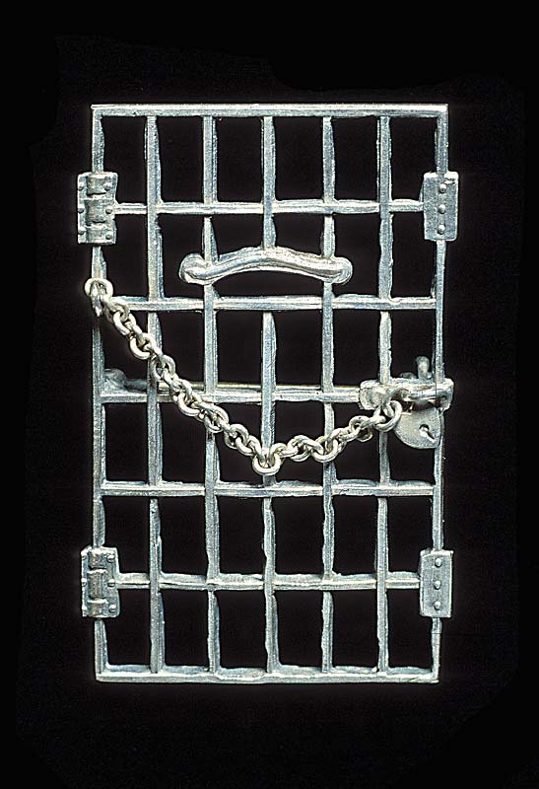
Alice Paul’s “Jailed for Freedom” pin
“Well behaved women seldom make history.”
-
Notes:
The final struggle for women’s suffrage was characterized by two distinct and often antagonistic approaches. Alice Paul’s National Women’s Party took the more confrontational path. She proudly presented this pin to the women who were “jailed for freedom” in the course of their service to the cause. Paul continued her tireless efforts for women’s rights throughout her long life. She lived to see the Equal Rights Amendment passed by Congress in 1972. Alice Paul died in 1977 at age 92 at a Quaker nursing home in her native New Jersey.
Carrie Chapman Catt continued her activist work, turning her attention to the cause of peace and disarmament. She had suffered cardiac problems for many years, and died of a heart attack in 1947 at her home in New Rochelle, New York. She is buried next to fellow suffragist Mary (Mollie) Garrett Hay with whom she lived for twenty years.
Which approach was more effective in achieving women’s suffrage: the radical or the moderate? Historian Judith Wellman argues, “You need a united movement. A movement that loses its radicalism loses its vision and its future. A movement that is only radical loses its mass base.”

Slide 51
June 10, 2019 Assembly Joint Resolution
“Resolved by the assembly, the senate concurring, That the Wisconsin State Legislature celebrates June 10, 2019, as the 100th Anniversary of ratifying the 19th Amendment and reaffirms Wisconsin’s commitment to empowering and uplifting the voices of women across our great state.”
Notes:
“Resolved by the assembly, the senate concurring, That the Wisconsin State Legislature celebrates June 10, 2019, as the 100th Anniversary of ratifying the 19th Amendment and reaffirms Wisconsin’s commitment to empowering and uplifting the voices of women across our great state.”

Slide 52
Notes:
Let’s conclude with Carrie Chapman Catt’s words to the newly enfranchised women voters of America in 1920:
“The vote is the emblem of your equality, women of America, the guaranty of your liberty. That vote of yours has cost millions of dollars and the lives of thousands of women. Women have suffered agony of soul which you can never comprehend, that you and your daughters might inherit political freedom. That vote has been costly. Prize it!
The vote is a power, a weapon of offense and defense, a prayer. Use it intelligently, conscientiously, prayerfully. Progress is calling to you to make no pause. Act!”
The suffragists were disappointed with the numbers of women who voted in that first 1920 election: only 1 in 3. It took until the 1960’s and the “second wave of feminism” for the number of women voting to equal the number of men. Not until 1980 did the percentage of women voters surpass men. In the 2018 midterm elections, women voted in greater numbers than ever recorded.
While we didn’t elect the first female president in 1916, are we now living in the midst of the “third wave of feminism”?

