Slide 1

The Miracle of the Grocery Store Paul Freiberg
November 2025

Slide 2

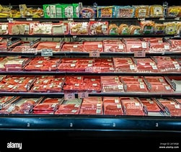
“Endless Abundance”

Slide 3
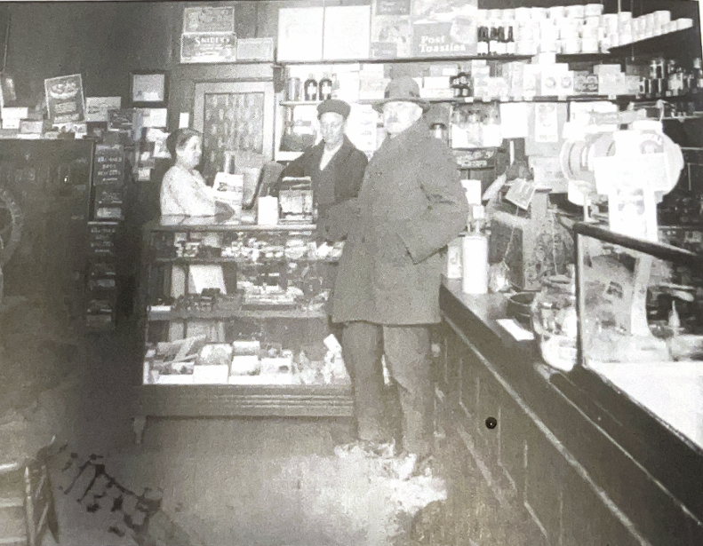
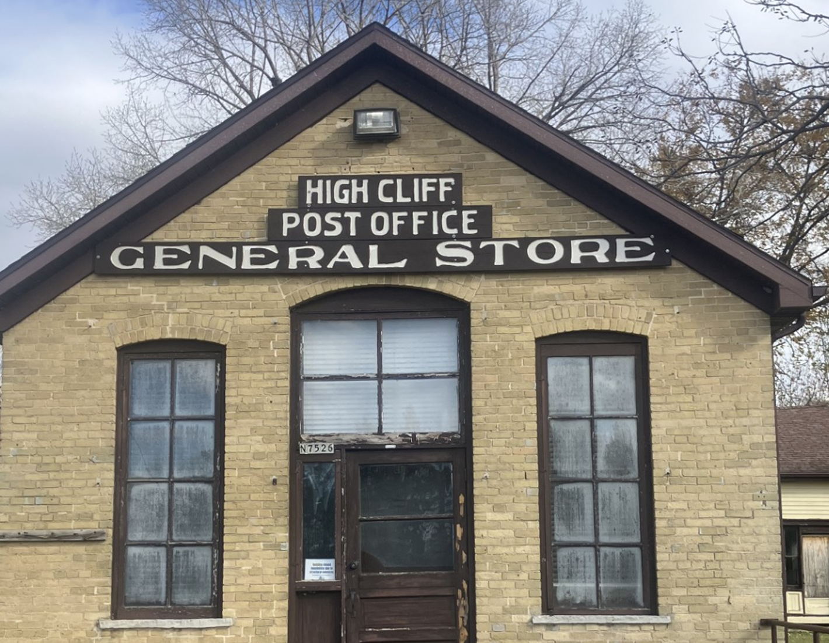
Early 1900s
Hollenbach
Notes:
Hollenbach to Jacobs

Slide 4
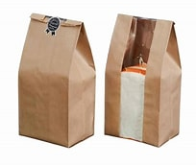

The Bag and the Box
These inventions changed modern life in general, and shopping in particular. Lorr

Slide 5
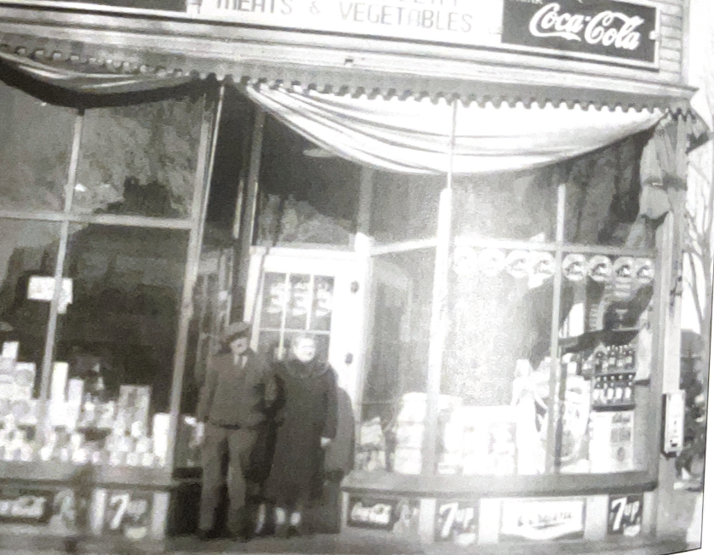
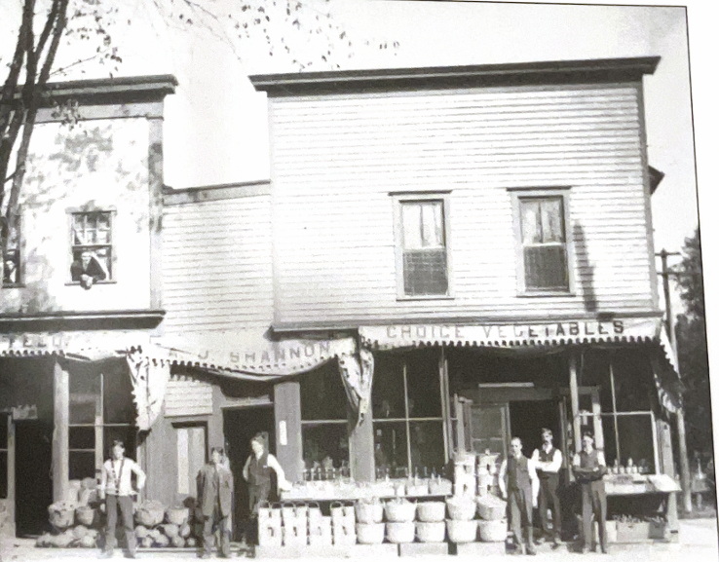
Appleton Grocery Stores
AJ Shannon
Otts
Home delivery flourished in early times
Notes:
Hollenbach to Jacobs

Slide 6
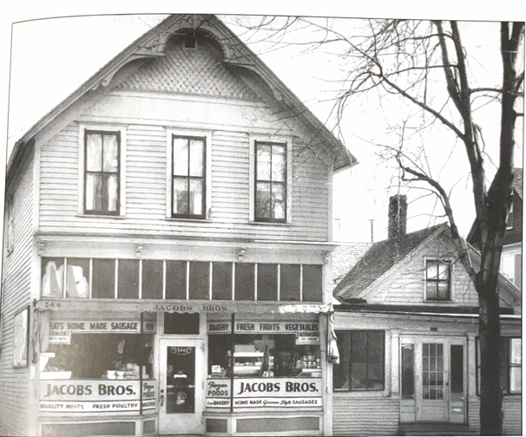
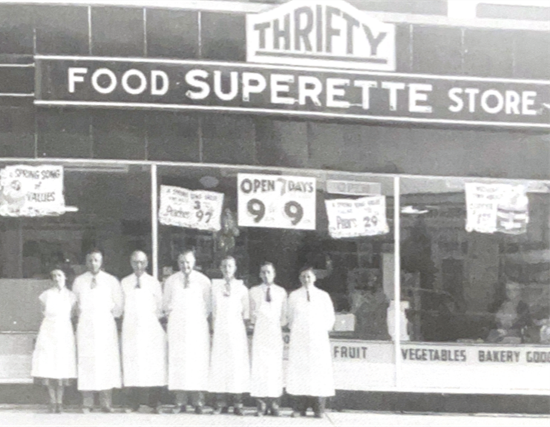
Appleton Grocery Stores
Jacob Bros.
Thrifty Superette
Notes:
Hollenbach to Jacobs

Slide 7
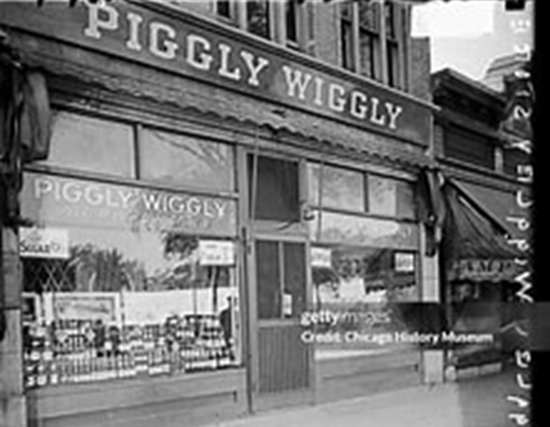
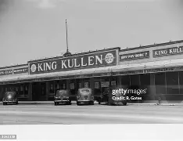
1916
1930
Notes:
Hollenbach to Jacobs

Slide 8
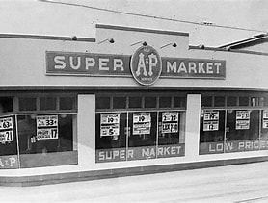
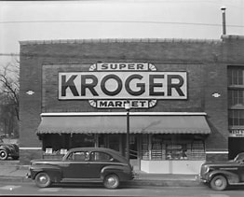
1940s – 1950s
Rise of the One Stop Grocery Stores

Slide 9
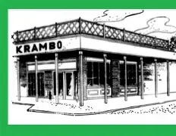
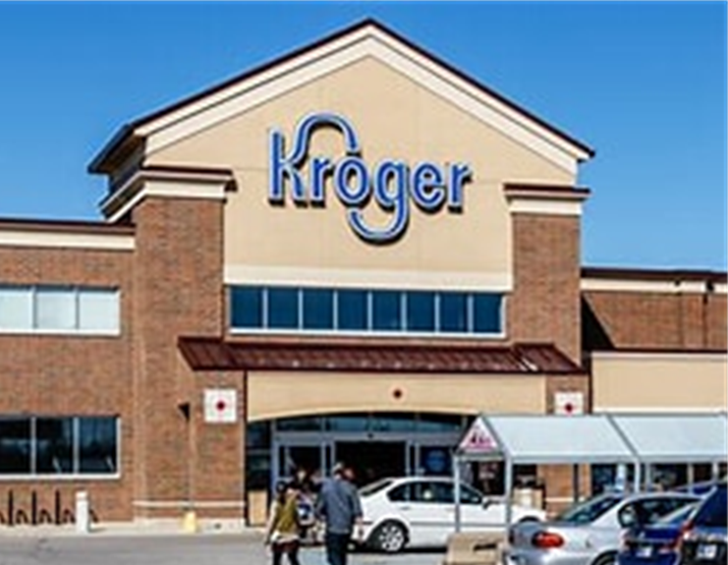
Transition
By 1956, “independent grocery was gone” - Ruhlman

Slide 10
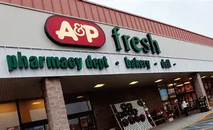
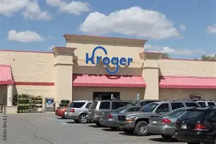
1970s
Kroger expands- A&P declines

Slide 11
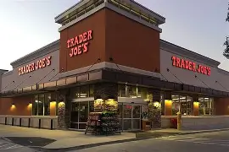
Trader Joe’s
“The correlation between education and alcohol is about as perfect as one can find in marketing.” – Joe Coulombe
Customers reflected their identity on the products they bought

Slide 12
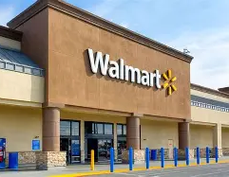
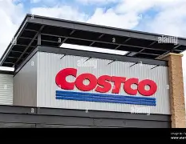
Walmart and Costco

Slide 13
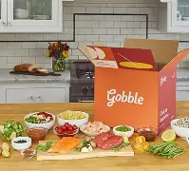
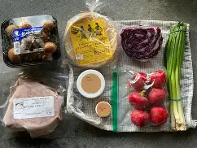
Prepared meals
Do we cook? Or do we assemble?

Slide 14
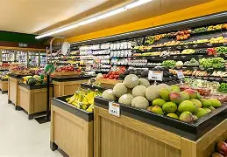
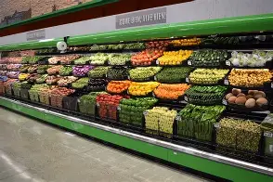
Produce all year

Slide 15
“Grocery shopping is a cunningly orchestrated process. Every feature of the store from the floor plan and shelf layout to the lighting, music and ladies in aprons offering free sausages on sticks is designed to lure us in and keep us there and seduce us into spending money.”
Rebecca Rupp at National Geographic.

Slide 16
Health
Organic
Paleo
Paleo
Fat-free
Grass fed
Natural
Gluten free
Low sugar
“Selling health (or the illusion of health) is hugely profitable.” - Lindstrom

Slide 17
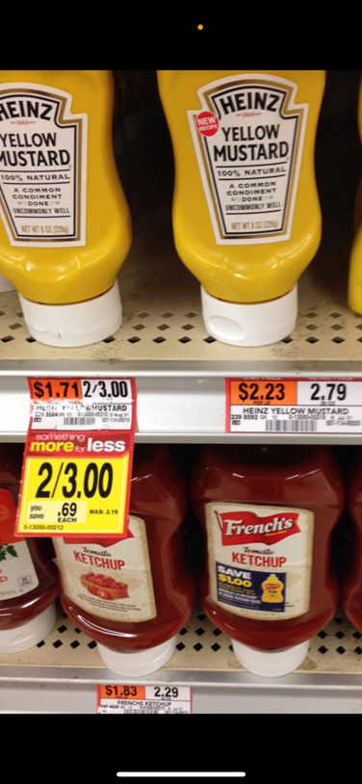
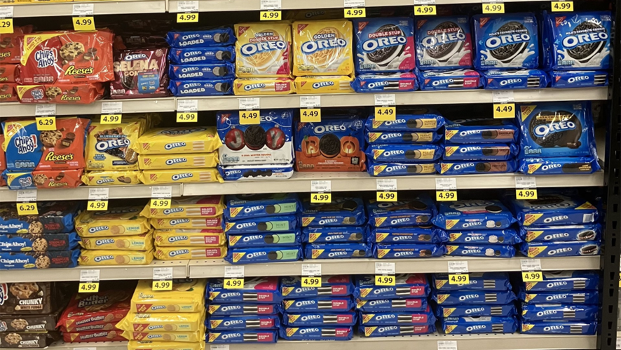
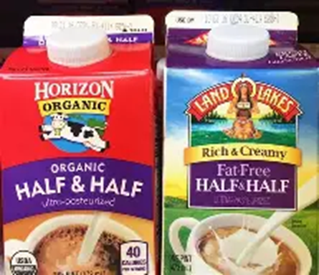
Endless Abundance
Did you find everything you wanted?

Slide 18
Food security problems
42 million Americans receive food assistance
12.3% of U.S. residents
$100 billion a year cost
Food deserts exist
Food waste – 66 million tons a year (EPA)

Slide 19
Some good news
1900 – 40% of home budget for food – 10% today
We spend less money on food than other countries
Shopping has become less of a burden
Transportation is no longer an obstacle

Slide 20
Current Random Initiatives
Test tube patties?
Reduce high fruticose corn syrup
Reduce artificial sweeteners
Define milk?
Reduce synthetic dyes
Define meat?
The future of health?

Slide 21
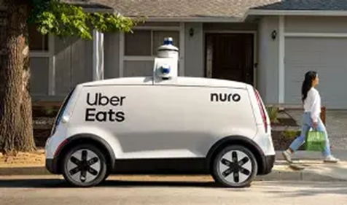
Food Delivery
Gen- X in the “driver” seat

Slide 22
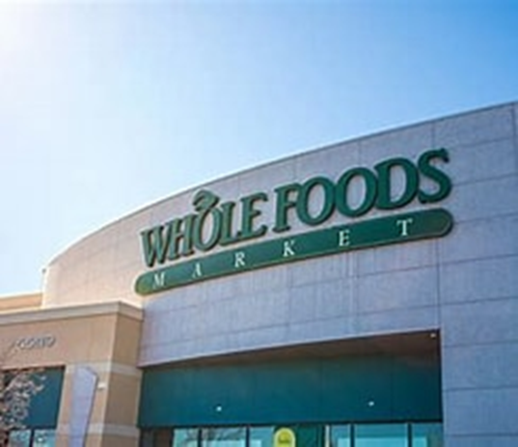
The Amazonification of Whole Foods
“Healthy” food in the aisles – junk food in the back – Wall Street Journal

Slide 23
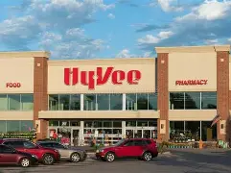
Experiential retail
Is it a store or a mall?

Slide 24

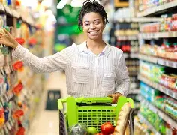
“Endless Abundance”

