Slide 1
MORE NUKES
LESS KOOKS
A new look at nuclear energy

Slide 2
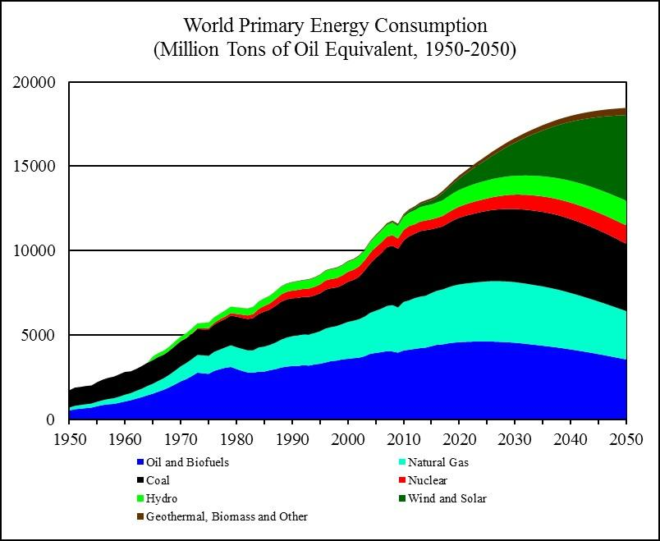
What we need

Slide 3
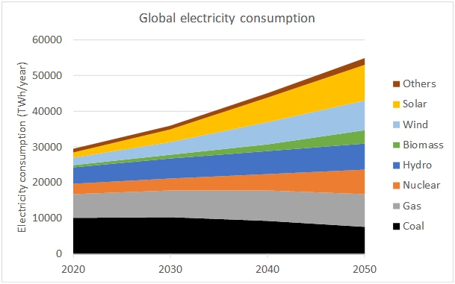
Going Electric

Slide 4
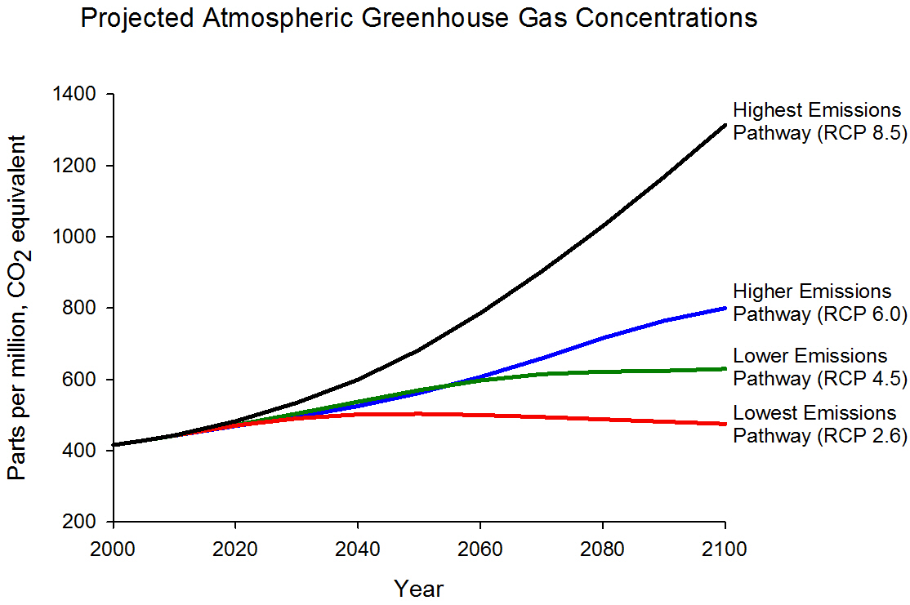

Slide 5
Nuclear power plants 2000-2022
150 nuclear powerplants have been built in the first two decades of the century by numerous countries.
How many in the U.S.? 1(online in 2016)
57 plants were under construction or brought online in 2023, led by China and India.
300 more plants are being proposed

Slide 6
Where are we headed with nuclear power?
Majority of recent installations are Gen III designs
Gen IV designs are in development stages (dating back to 1950)
China, Russia, and some EU countries are leading the way.
In the U.S., NuScale and Terrapower are primary proponents of Gen IV design

Slide 7
Why Nuclear Energy
Represents the Future
Emmission free
Safety
Dependable
Versatile
Small land footprint

Slide 8
More Reasons
Minimal waste
Hydrogen production
Low cost
New designs (more later)
Future potential of fusion (a different rabbit-hole)

Slide 9
Gen IV Designs
Molten Salt/Sodium cooled reactors
Lead cooled fast reactors
Gas cooled reactors
Small modular reactors
Micro reactors

Slide 10
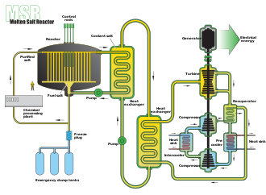
Molten Salt Reactor

Slide 11
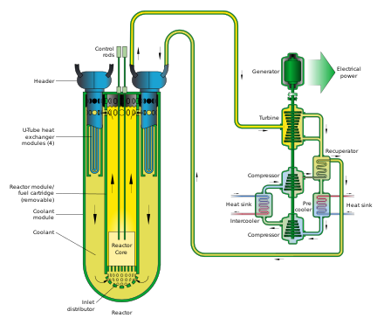
Lead-cooled Fast Reactor

Slide 12
Gen IV advantages
Small footprint
Vastly reduced materials/construction costs
“Walk-away” safety systems
Reduced waste volume
30% improved efficency over LWR
Refueling during operation
Ability to “burn” harmful actinides

Slide 13
Pathway for the Future?
International education on nuclear energy
Carbon tax implementation
Level energy playing field
Revise licensing/regulatory rules
Government policy changes

